Slide 1
Kingdom Protista

Slide 2
Kingdom Protista
Imagine you’ve take a sample of pond water and look at it under a microscope. You see tiny organisms of various shapes, colours and sizes. These organisms may all seem very different but they are all members of Kingdom Protista. These organisms are not necessarily closely related to each other…they are classified together because they do not fit into the other kingdoms!
They are classified into 3 major groups based on their type of nutrition (the food they eat).
Protozoa (animal-like protists) are heterotrophs that ingest or absorb their food.
Algea (plant-like protists) are autotrophs that carry out photosynthesis.
Slime moulds and water moulds are fungus-like and heterotrophic.

Slide 3
Protozoa (Animal-like Protists)
Protozoa obtain their food by feeding on other organisms or dead matter. Some are scavengers that absorb or ingest materials from their surroundings. There are parasitic species that can even live inside of humans.
Protozoa vary in shape and size. Most live as single cells but some form colonies. No protozoa have cell walls.
Many protozoa, especially parasitic species, have complex life cycles with multiple stages. Sometimes the life cycle stages are so different from each other that the organisms have been mistaken for completely other organisms .
Most protozoa can move, and species are usually classified in four phyla (see Classification of Life notes) based on their methods of locomotion

Slide 4
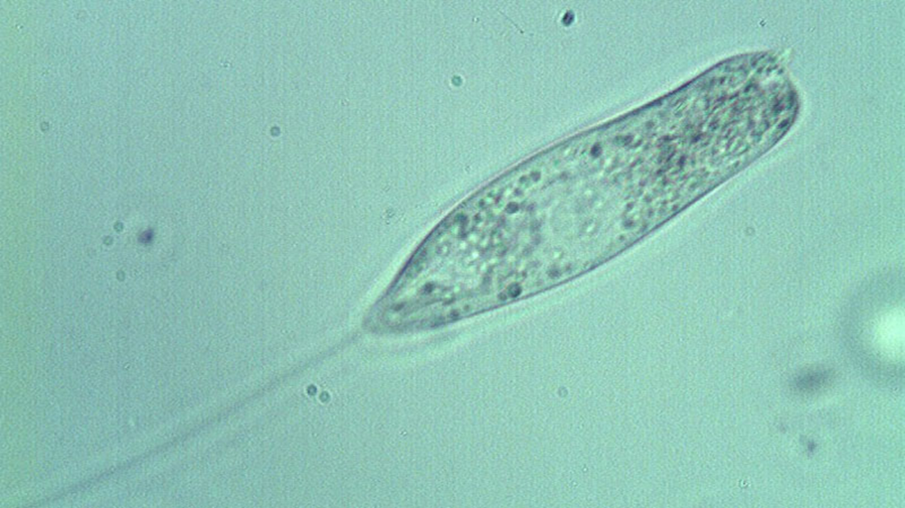
Protozoa: Flagellates (Phylum Zoomastigina)
These organisms have one or more flagella that whip from side to side for movement.
Have a hard protective covering over their outer membrane.
Some are free-living, some are parasites and some live in symbiotic relationships (interactions between species that can be positive, negative or neutral).
Among the symbiotic flagellates are many species that live in the digestive tracts of animals that help the animal digest the plant material they are eating
For example: termites feed on wood, but they are unable to digest the tough cellulose that makes up a large part of their diet. Flagellates live in termite guts and produce enzymes that convert cellulose to a food source that the termites can use. In return, the flagellates receive a steady supply of food and a warm, protected environment.

Slide 5
Symbiotic Relationships
There are three basic types of symbiotic relationships:
Mutualism is when both species benefit from the relationship.
Goby fish and shrimp. The nearly blind shrimp and fish spend most of their time together. The shrimp builds a burrow in the sand for them to both live in. When a predator comes near, the fish warns the shrimp and they both burrow until the predator is gone.
2. Commensalism is when one species benefits while the other is not affected.
Mites attach themselves to larger flying insects to get a free ride. Also, hermit crabs use the shells of dead snails for homes.
3. Parasitism is when one species benefits (the parasite), while the other is harmed (the host).
Roundworms are parasites of mammals, like humans, cats and dogs. The worms produce a huge number of eggs which are passed in the host’s feces to the environment. Hosts get infected by swallowing the eggs in contaminated food or water.

Slide 6
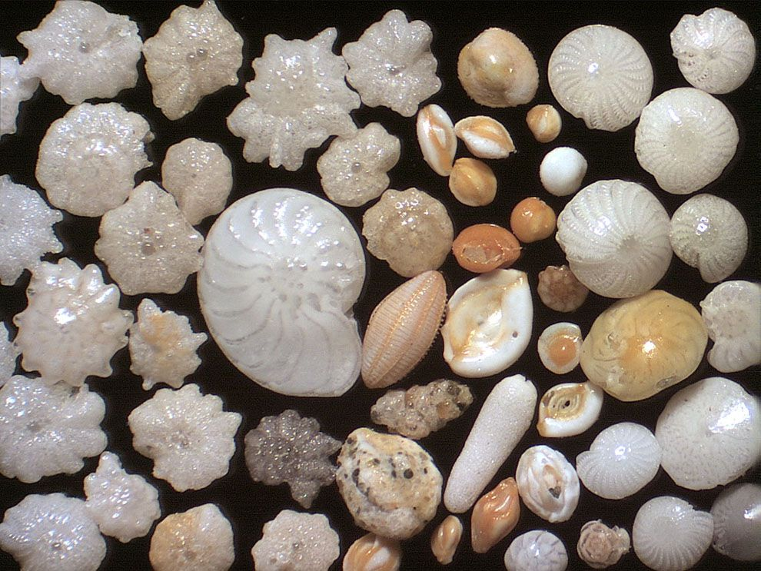
Protozoa: Sarcodines (Phylum Sarcodina)
Also known as amoeba, they move and engulf their prey by producing feet-like extensions of their cytoplasm called pseudopodia (pseudo = false, podia = feet).
Foraminifera are marine amoeba that have shells made of calcium carbonate. They are very abundant and much of the ocean floor is made of their shells that have piled up over millions of years.

Slide 7
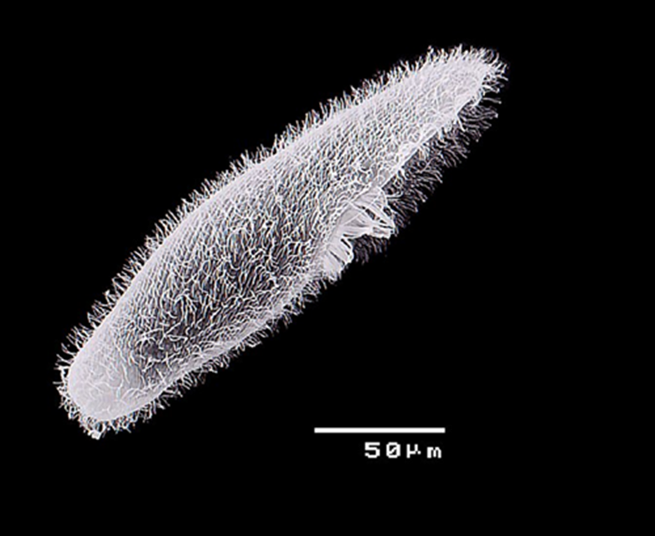
Protozoa: Ciliates (Phylum Ciliophora)
Paramecium is a common ciliate protozoan found in ponds. It is covered by hundreds of cilia that move in a coordinated rhythm to help the micro-organism move. The cilia also help to sweep food particles into their “mouth” structure.
Many species of ciliates are relatively “large” and complex – they can grow up to 0.1mm.
Just like the flagellates (slide 17), ciliates can be free-living, symbionts or parasites. Only one species is known to parasitize humans – Balantidium coli lives in the large intestine and causes diarrhea.

Slide 8
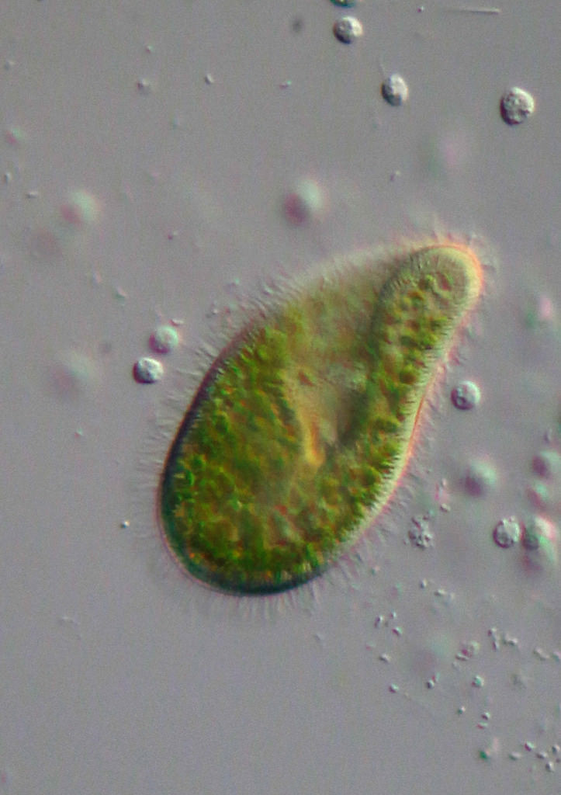
Protozoa: Sporozoans (Phylum Sporozoa)
Sporozoans are parasites. The name of the group comes from the fact that they form spores at some point in their life cycle.
They have a complex life cycle that is adapted to transferring their offspring from one host to another. They contain complex organelles at one end of their bodies that help them invade their host.

Slide 9
Plasmodium vivax (Malaria) Life Cycle
Plasmodium vivax is a sporozoan that causes one type of malaria in humans. The parasites pass into the bloodstream when a person is bitten by an infected mosquito.
Mosquitos feed on a person infected with malaria, they ingest reproductive Plasmodium vivax cells with the blood they drink.
The reproductive parasitic cells fuse inside the mosquito to form a zygote (when sperm and egg unite). This zygote begins to divide many times to produce spores called sporozoites.
The sporozoites move to the mosquitos salivary glands and will be injected into the next human that the mosquito bites.
Inside the human, the sporozoites reproduce to produce more spores in the liver. From the liver, the spores move to the red blood cells and multiply rapidly inside of them.
The blood cells burst and release the spores inside. The spores go on to infect more red blood cells.
The cycle repeats.

Slide 10
Symptoms of malaria include:
Fever
Chills
Headache
Nausea & vomiting
Muscle pain & fatigue
Malaria can be fatal if left untreated!

Slide 11
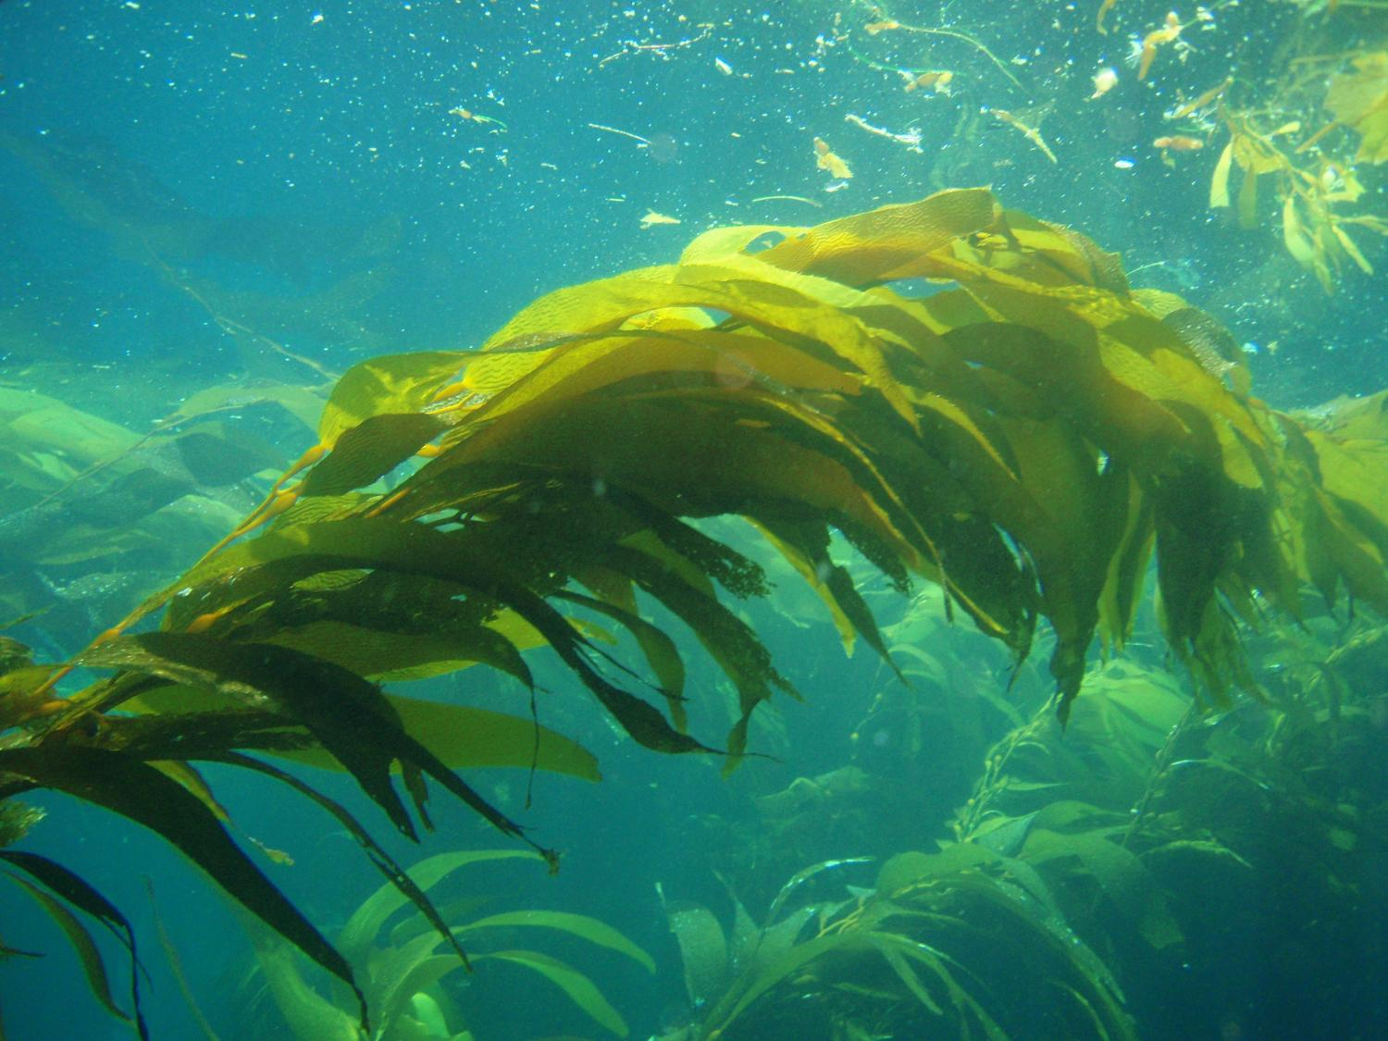
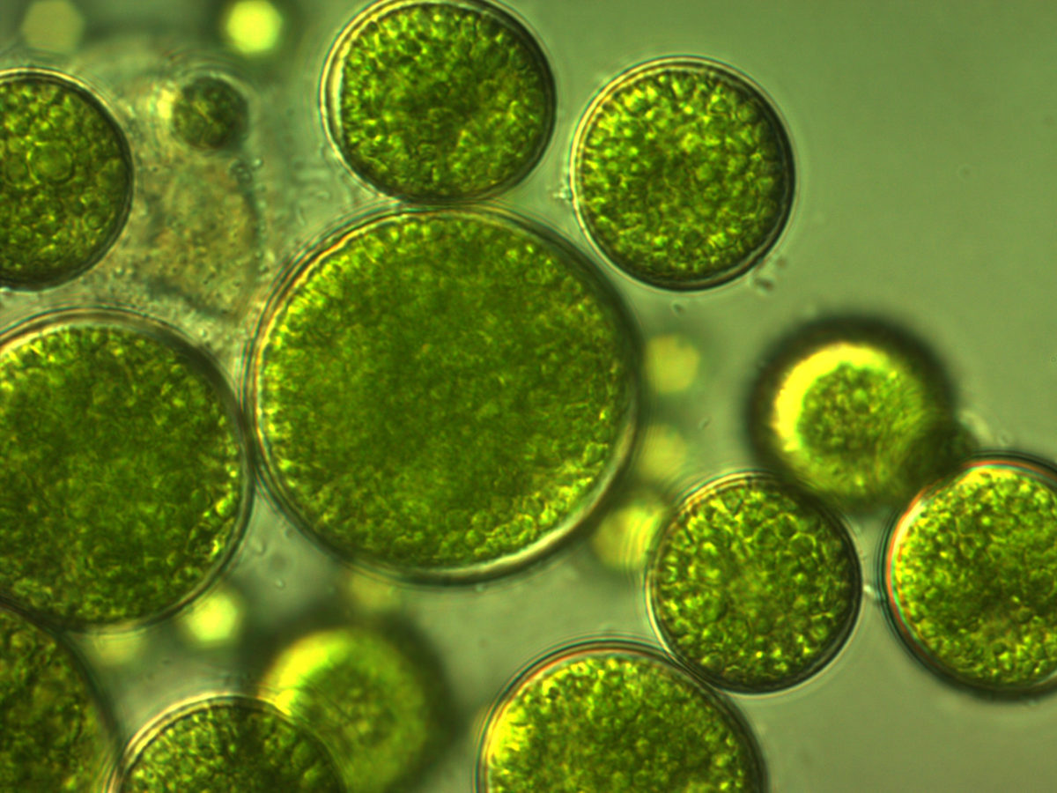
Algae (Plant-like Protists)
Algae are simple, aquatic organisms. They range in size from single cells that live in puddles to giant seaweeds that are 60 m in length.
Because these organisms carry out photosynthesis, they were once classified as plants but they lack stems, leaves and roots so that classification eventually changed.
Algae have been on Earth for more than 2 billion years and scientists are still discovering new species.
Algae are classified based on the type of chloroplasts and pigments they contain. Chloroplasts are organelles found in plants and algae that perform photosynthesis.
Algae range from being multicellular to unicellular. Other differences include the chemistry of their cell walls, the number and position of flagella if they have any and the form that food storage takes in their cells.

Slide 12
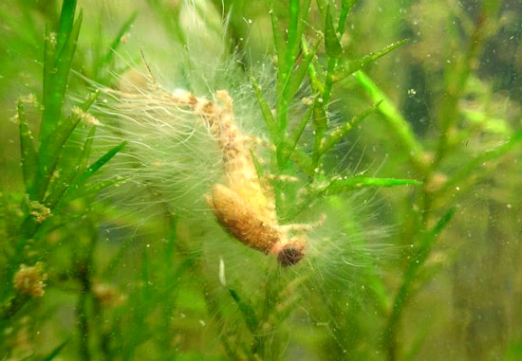
Slime and Water Moulds (Fungus-like Protists)
These are difficult to classify as they have characteristics of fungi, protozoa and plants. But since they do not fit nicely into any other group, Kingdom Protista is the perfect place to classify them.
Water moulds (Phylum Oomycota): Most feed on dead matter (they are saprotrophs) but some are parasites on fish, insects and plants. They grown “filaments” which they extend into the bodies of their prey, where they then release digestive enzymes and absorb the nutrients.

Slide 13
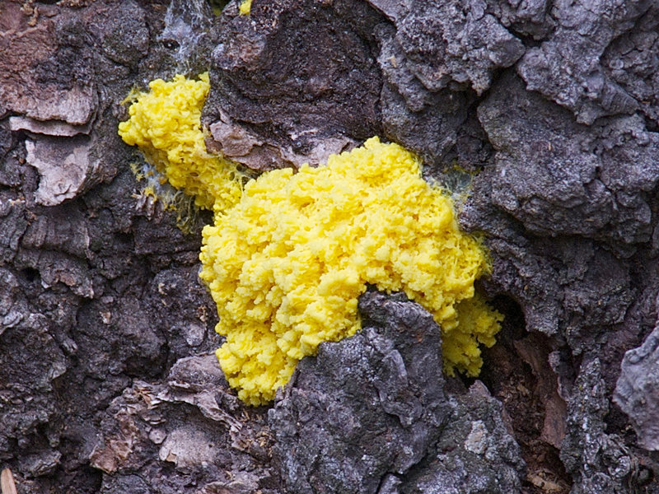
Slime and Water Moulds (Fungus-like Protists)
Plasmodial slime moulds (Phylum Myxomycota): Visible to the naked eye as tiny slug-like organisms that creep over damp, decaying plant material in forests and fields. They feed by engulfing small particles of food into their cytoplasm.
Plasmodial slime moulds are able to produce spores that allow them to survive when conditions are dry. When damp conditions return, the spores germinate and grow into new slime moulds.

