Slide 1
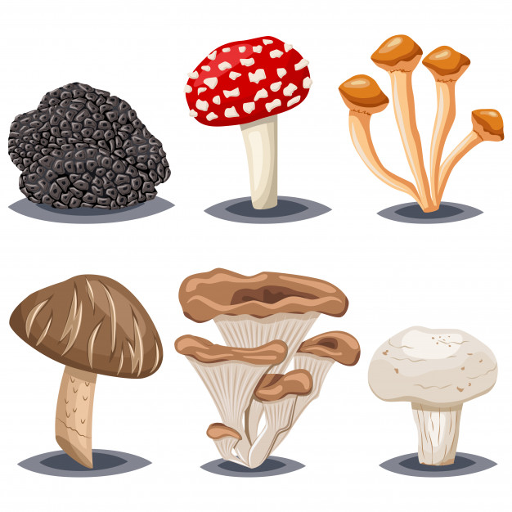
Kingdom Fungi

Slide 2
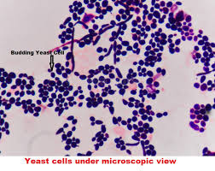
Kingdom Fungi
The mushrooms you see in the forest or in your yard may remind you of a plant but they also have much in common with animals!
Mushrooms, moulds, mildews, and yeasts are all members of Kingdom Fungi. Like animals, fungi are heterotrophs
They feed by releasing digestive enzymes into their surroundings, then absorbing the digested nutrients into their cells.
Some funguses, like yeast, are unicellular but most of them are multicellular.

Slide 3
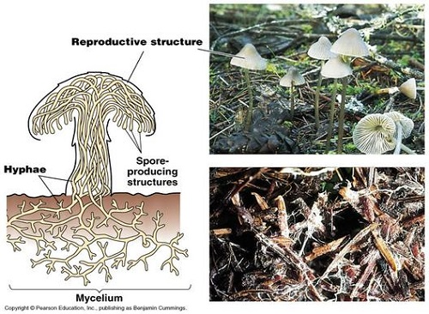
Kingdom Fungi
Multicellular fungi have bodies made up of hyphae (singular hypha), which are a network of fine filaments.
In a mushroom, the hyphae are densely packed together in a tight mass and it is difficult to see the separate structures. BUT the mushroom that you see above ground is actually only a specialized reproductive part of the fungus.
The main bulk of the organism is under the soil in the form of loose, branching network of hyphae called mycelium.

Slide 4
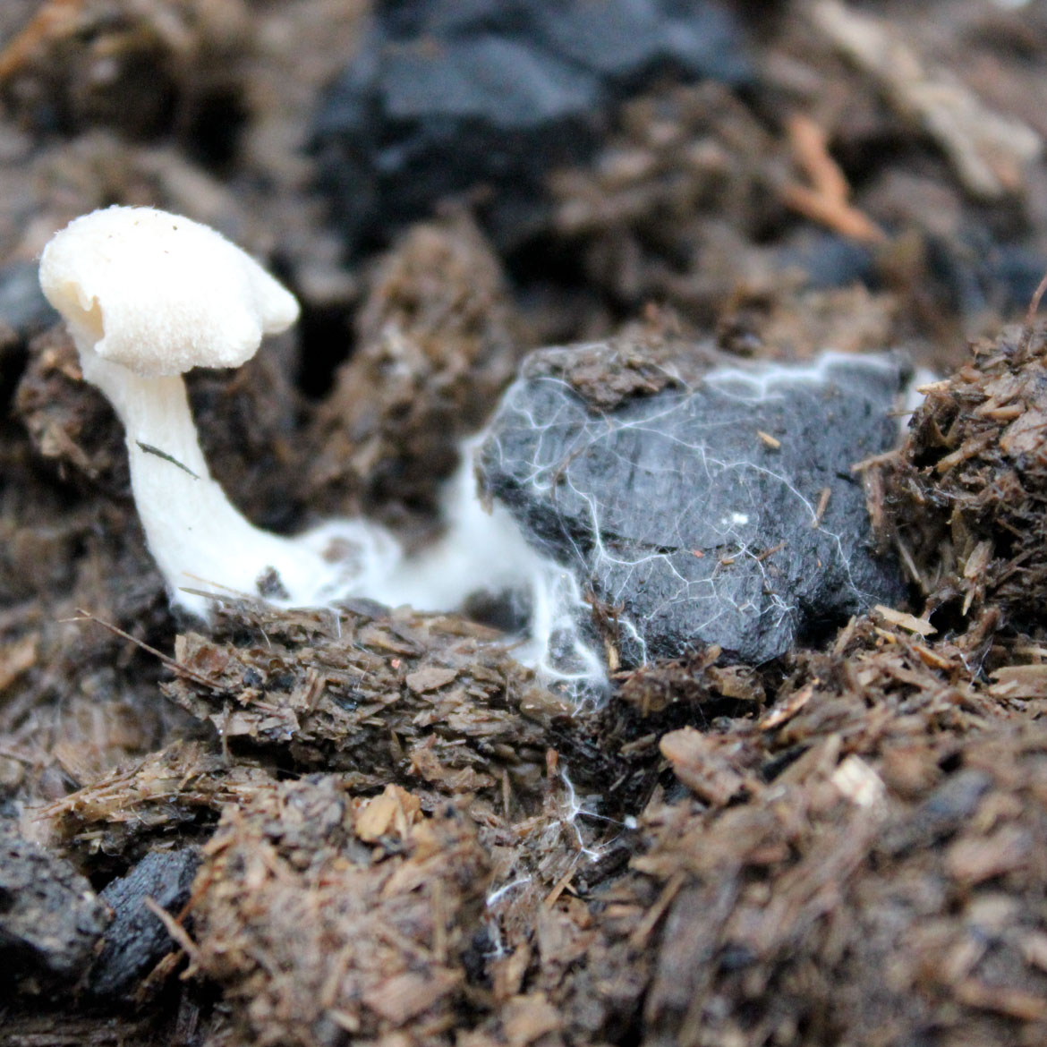
How Fungi Feed
Most fungi are saprophytes (sap-ro-fights) which means they break down dead matter and play a vital role in recycling nutrients.
As hyphae grow across a source of food (bread, dead wood, an orange peel, etc…), they release digestive enzymes. These enzymes break down large organic molecules into smaller molecules.
Because this “digestion” occurs outside the body of the fungus is it referred to as extracellular digestion.
The small molecules diffuse into the fungus, where they are used for growth, repair and other cellular processes. The bigger the mycelium of the fungus, the more surface area available for absorbing nutrients.

Slide 5
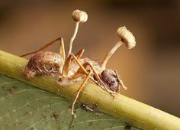
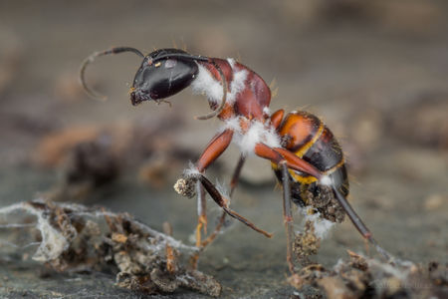
How Fungi Feed
Some fungi are parasites of plants and animals.
Parasitic fungi are specialized to feed on living cells. They produce hyphae called haustoria which can penetrate host cells without killing them immediately.
The Cordyceps fungus is a great example. When a spore of this fungus lands on an ant, it grows into the ants body. Hyphae slowly spread through the ant like a cancer and digests the ants tissues. Nature is badass.

Slide 6
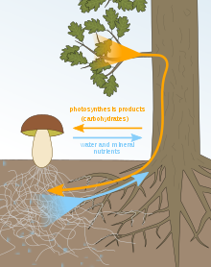
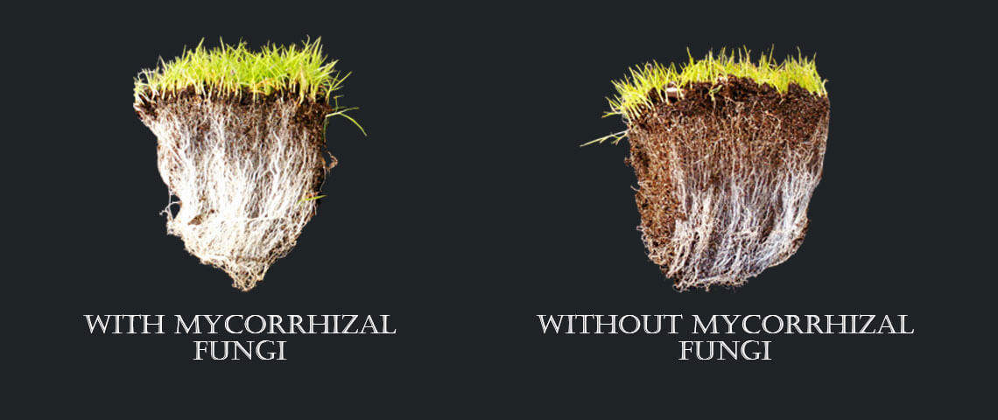
Symbiotic Fungi
Many fungi exist in mutualistic relationships with plants and animals where each species benefits from the relationship.
For example: Most trees have fungi living in close contact with their roots. They are called mycorrhiza (my-core-rise-ah). Fine, thread-like hyphae grow from the fungus into the plant roots. The hyphae absorb minerals from the soil and release them into the roots. So basically, the fungus increases the plants ability to absorb nutrients and the fungus benefits by receiving essential nutrients from the plant to survive.

Slide 7
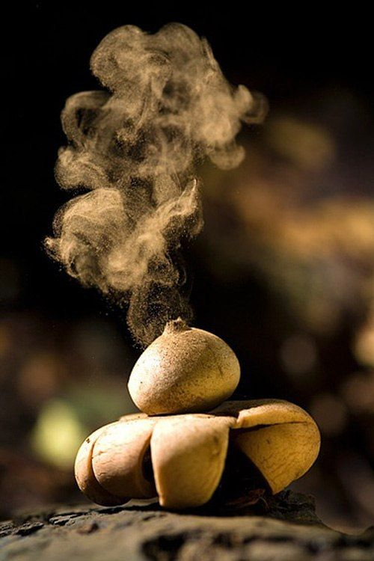
How Fungi Reproduce
Many fungi are able to reproduce both sexually and asexually. The simplest asexual method is fragmentation:
Pieces of hyphae break off and grow into new mycelia (plural for mycelium). This can happen in many ways, a gardener digging into the ground or a burrowing animal. The mycelium is broken up into fragments and each become their own individual entity.
Most fungi live on land and have adapted to produce spores which are windblown reproductive cells that help the fungi disperse to new locations. Spore-bearing structures help keep the spores from drying out and in order to ensure survival and dispersal, spores are produced in VAST numbers (literally billions or trillions of spores can be released from a single fungus)

Slide 8
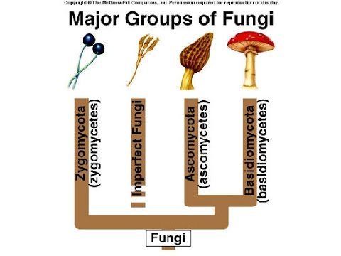
Classifying Fungi
The original ancestors of fungi are not known! It is likely that different groups of fungi living today have evolved from more than one origin.
At one time, fungi were thought to be included in the plant kingdom. Now, they form their own separate kingdom, with 4 subgroups:
Zygospore fungi
Club fungi
Sac fungi
Imperfect fungi

Slide 9
Zygospore Fungi (Phylum Zygomycota)
If you’ve ever seen mouldy bread, then you’ve seen this kind of fungi. The small black/blue dots you see are the reproductive structures.
During sexual reproduction, this fungus produces structures called zygospores after two hyphae of different types meet and fuse their nuclei together. After the zygospore has been formed, a thick wall develops around it to protect it and it remains dormant until better conditions for growth arise.
The mycelium of bread mould is made up of 2 forms of hyphae:
Horizontal growing hyphae called stolons that spread out over the breads surface
Downward growing hyphae called rhizoids that penetrate the bread and anchor the mycelium.
When conditions are suitable for growth, the zygospore begins to grow and develops a stalk-like hyphae called sporangiophores, that carry sporangia which release spores. And this continues!

Slide 10
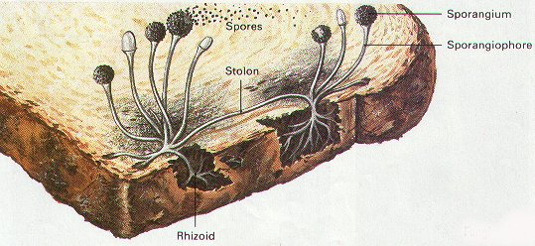
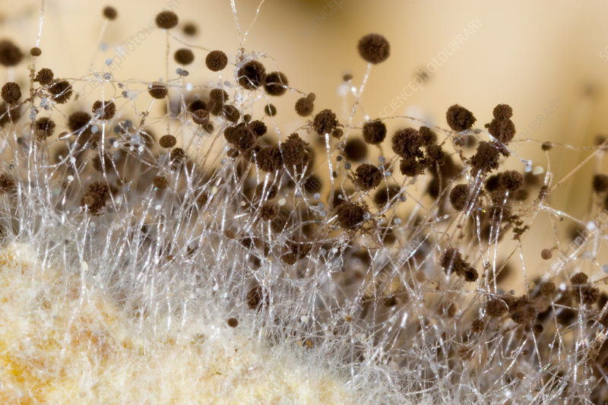

Slide 11
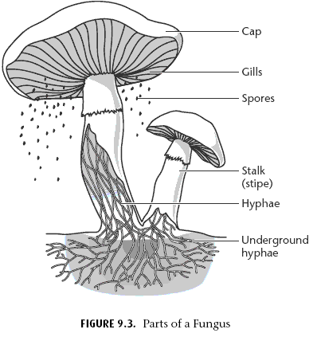
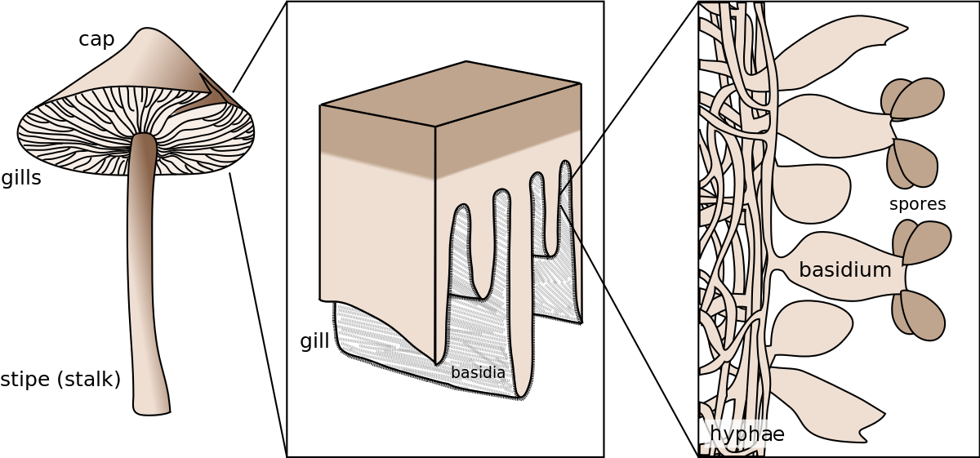
Club Fungi (Phylum Basidiomycota)
This phylum includes mushrooms that grow on lawns and dead tree trunks. They are all short-lived reproductive structures called fruiting bodies or basidiocarps.
They bear spores called basidiospores on club-shaped hyphae called basidia.

Slide 12
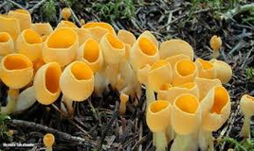
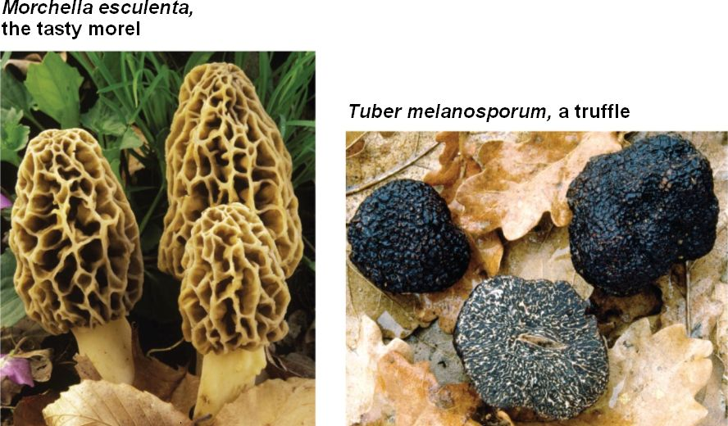
Sac Fungi (Phylum Ascomycota)
This is the largest group of fungi and these can range from mildew on leaves to the morels and truffles that are used in gourmet cooking.
They are identified by small fingerlike sacs called asci which are developed during sexual reproduction.
Most sac fungi are saprotrophs that break down hard-to-digest materials in wood and bone. Other species are parasites of plants.
These fungi develop spores directly at the tips of hyphae that are exposed to the air and released spores then travel by wind, water or even animals.
This group also includes yeast!

Slide 13
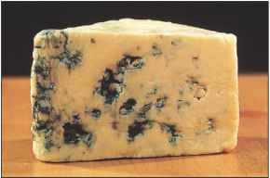
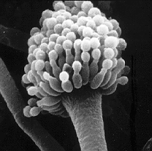
Imperfect Fungi (Phylum Deuteromycota)
Imperfect fungi only reproduce asexually and do not have a sexual phase like other fungi. This is how they got their name!
They develop mycelia from spores called conidia.
This is a diverse and very important group. The antibiotic penicillin was first obtained from a species of mould called Penicillium. Other imperfect fungi are used to make soy sauce and blue cheese!

