Slide 1
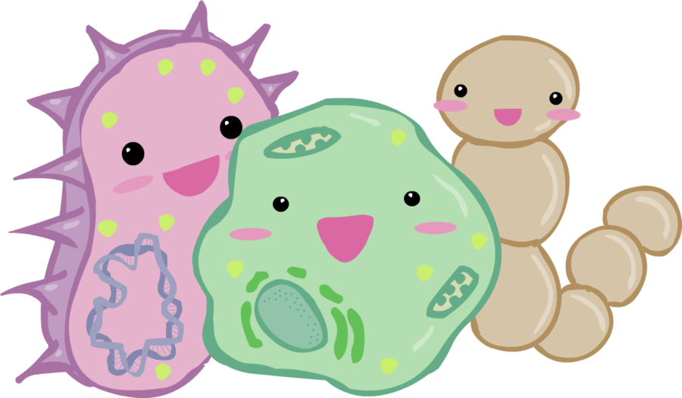
Kingdom Bacteria

Slide 2
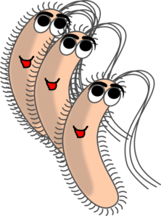
Kingdom Bacteria
When most people think of bacteria, they think of pathogenic organisms. AKA germs.
These types represent a tiny fraction of bacteria!
Bacteria play a necessary role in our environment, and are used to make many foods including yogurt and cheese!

Slide 3
Kingdom Bacteria
Bacteria are PROKARYOTES (unicellular organism with NO nucleus or any other organelles)
The majority live as single cells; some produce colonies or link up to form chains.
Some move using flagella, some do not move at all!

Slide 4
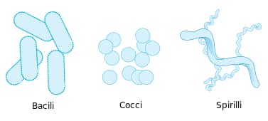
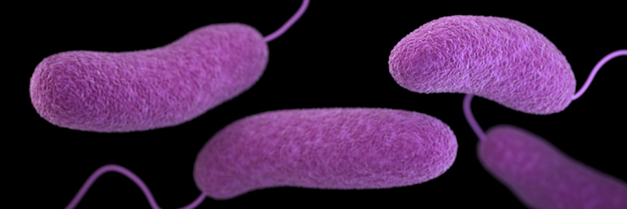
Classifying Bacteria - Shape
There are 4 main shapes!
Cocci, or round
Bacilli, or rod shaped
Spirilli, or spiral shaped
Vibrio, or comma shaped

Slide 5
Classifying Bacteria - Shape
Bacteria often grow in characteristic patterns, or groupings.
We use the prefix diplo when they are arranged in pairs, staphylo when they are arranged in clusters and strepto when they are arranged in a chain.

Slide 6
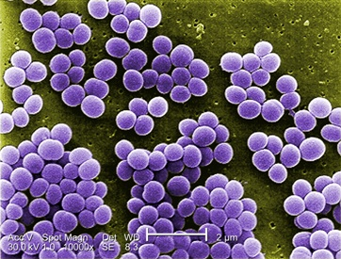
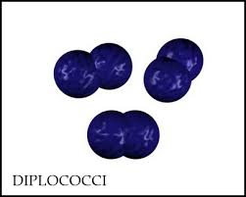
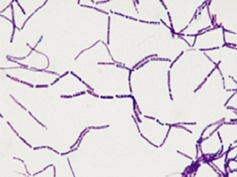
Staphylococcus
Streptobacillus

Slide 7
Classifying Bacteria - Cell Wall Structure
Bacteria differ slightly in the structure and thickness of their cell walls.
There is a stain that allows these differences to be seen called Gram stain.
The stain highlights basic differences in the arrangement of amino acid and sugar molecules in the cell walls.

Slide 8
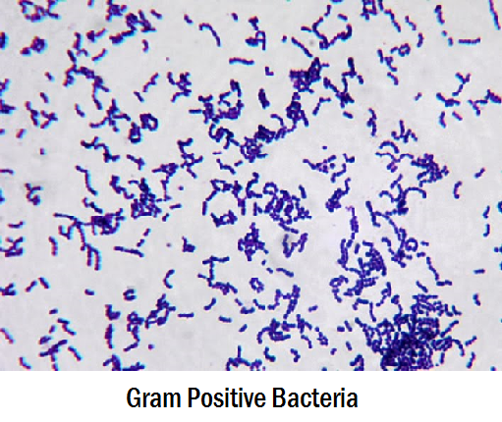
Classifying Bacteria - Cell Wall Structure
Gram-positive bacteria have a thick cell wall composed mainly of peptidoglycan (a large molecule made of carbohydrates and proteins).
These bacteria stain purple!

Slide 9
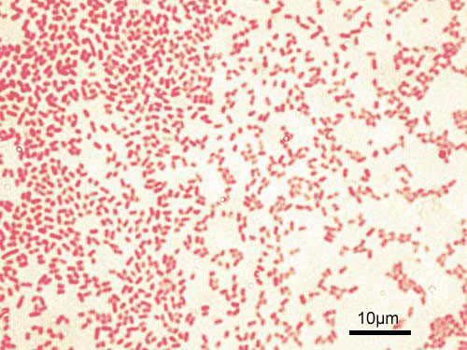
Classifying Bacteria - Cell Wall Structure
Gram-negative bacteria have two cell walls; the thin inner wall is made of peptidoglycan. These cells stain pink.
This group is larger and more diverse.

Slide 10
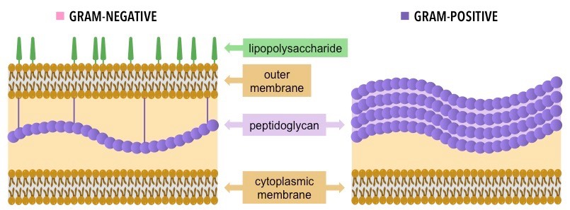
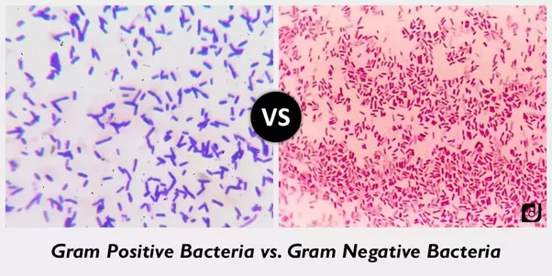
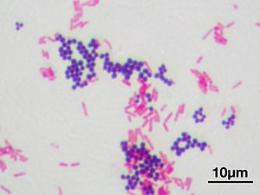

Slide 11
Classifying Bacteria - Nutrition
Bacteria need a source of energy, nutrients and suitable physical conditions just like every other living organism.
But, bacteria can use many different sources and still thrive. This is why bacteria are found everywhere!

Slide 12
Classifying Bacteria - Nutrition
Based on their source of energy, bacteria can be grouped into 4 major types.
Photoautotrophs – these bacteria use energy from the sun to create their own food.
Photoheterotrophs – not many bacteria use this method. They use light from the sun for energy yet still have to obtain their own food

Slide 13
Classifying Bacteria – Nutrition Continued
3. Chemoautotrophs – these bacteria break apart chemical compounds, like hydrogen sulfide and ammonia for energy and use this energy to create their own food.
4. Chemoheterotrophs – organisms that get their energy from chemicals. You are a chemoheterotroph!

Slide 14
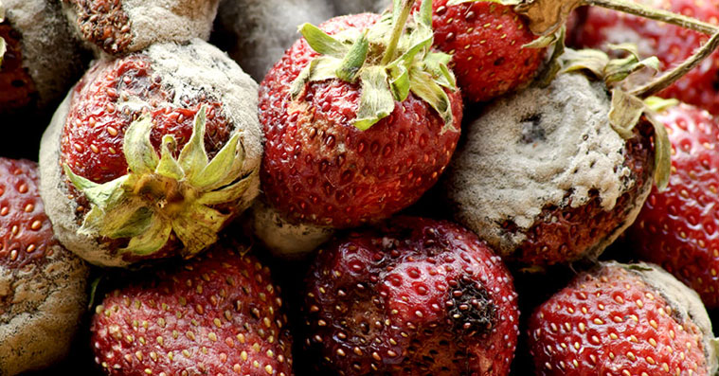
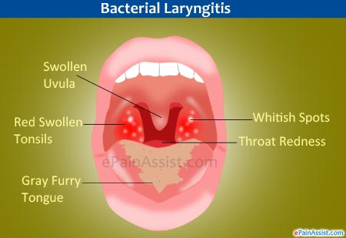
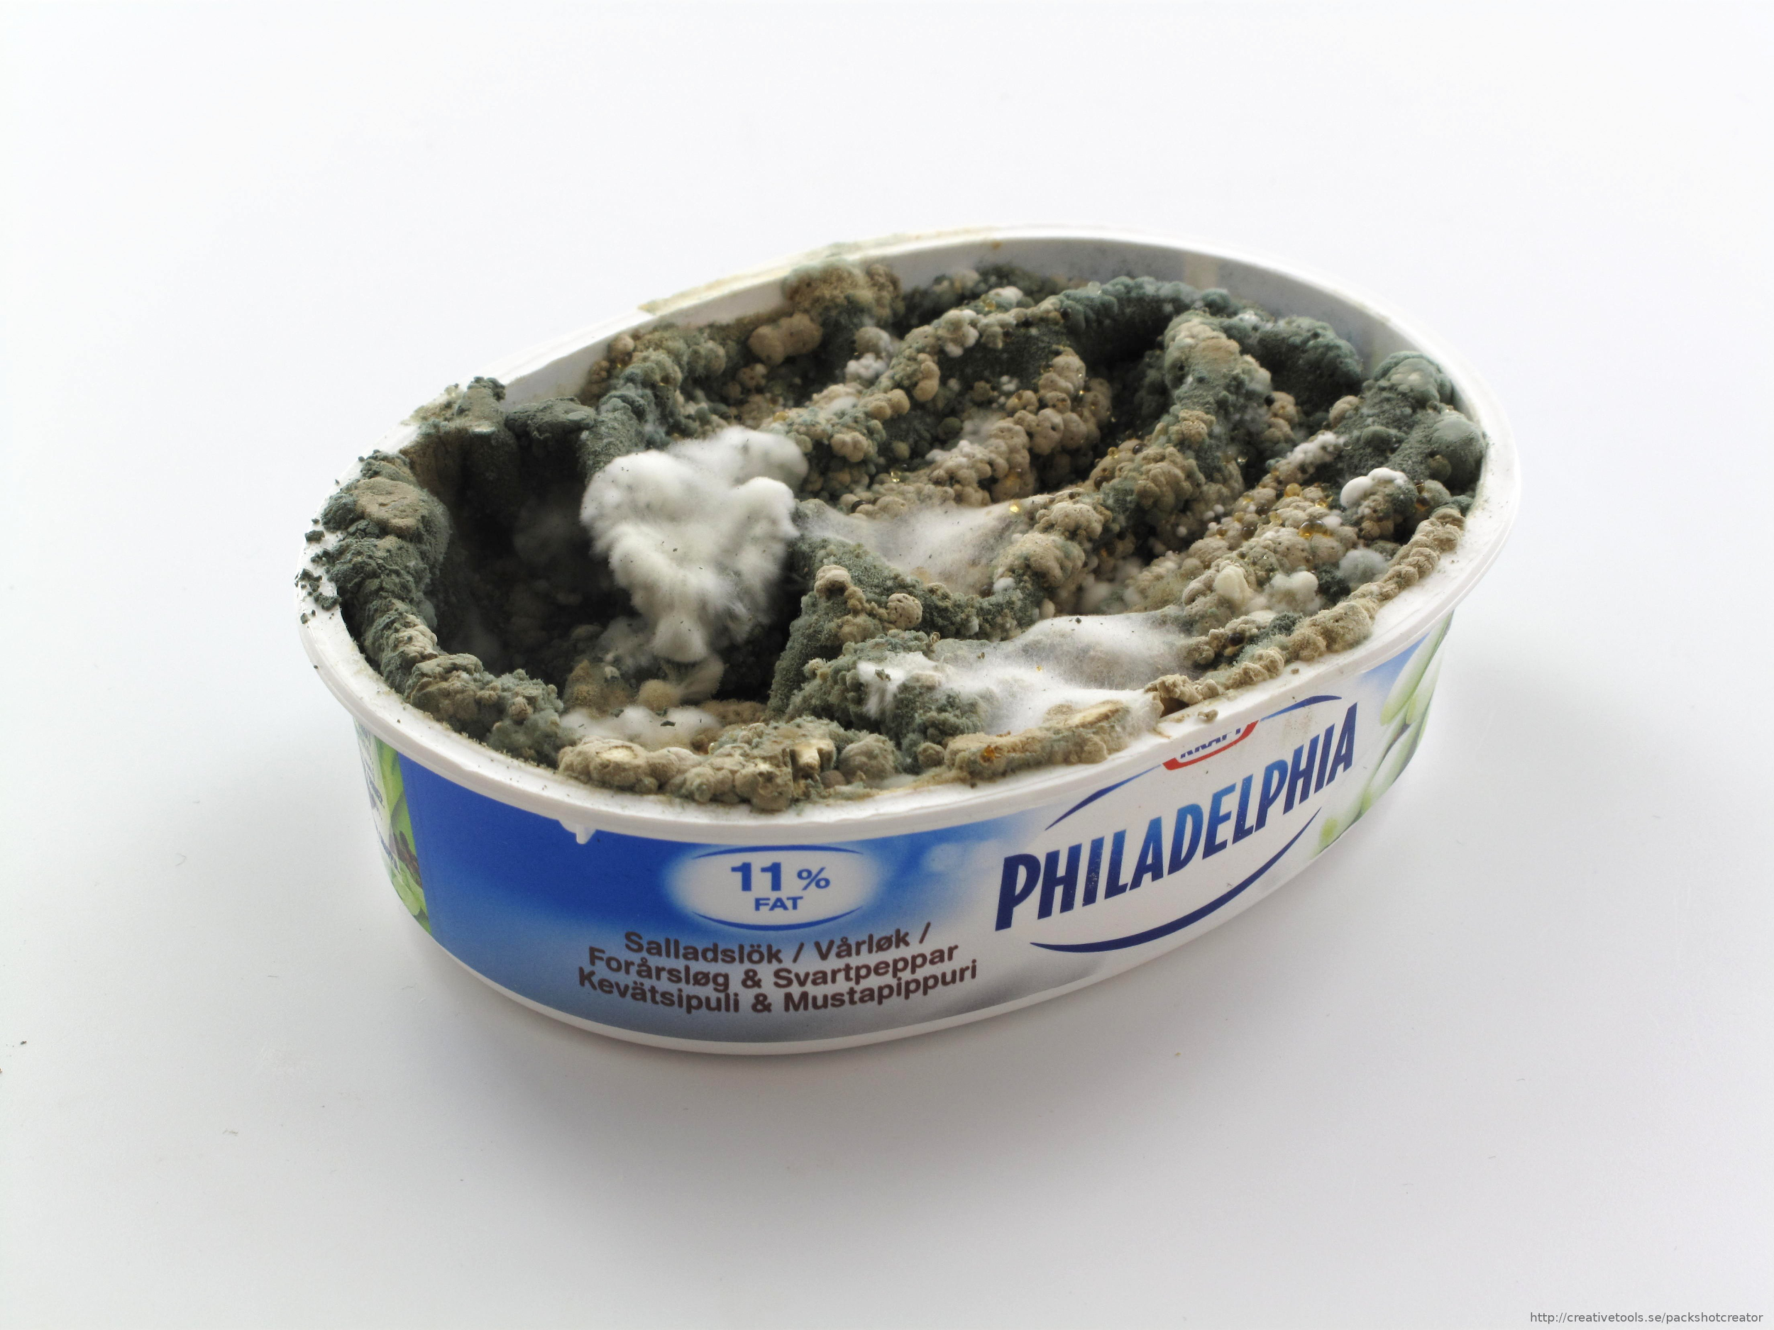
How Bacteria Reproduce

Slide 15
How Bacteria Reproduce - Asexual Reproduction
Bacterial cells cannot reproduce by mitosis or meiosis (as plant or animal cells do). WHY?
Because their cells do NOT have nuclei! Their genetic material is contained in a single chromosome within the cell and is basically free floating.

Slide 16
How Bacteria Reproduce - Asexual Reproduction
One method that bacterial cells reproduce by is binary fission
As a bacterial cell grows, it makes a copy of its chromosome. When the cell reaches a certain size, it elongates, separating the two chromosomes.
The cell builds a partition (wall) and the original cell splits into two.

Slide 17
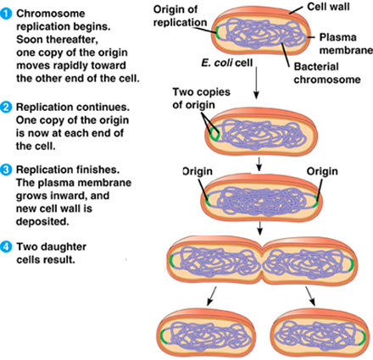
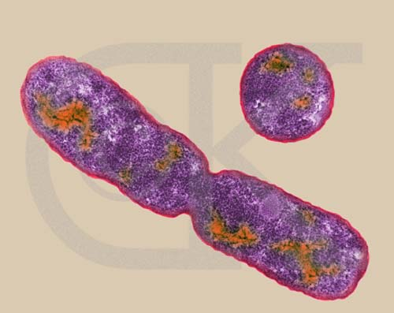

Slide 18
How Bacteria Reproduce - Asexual Reproduction
In favourable conditions, a bacterium can grow and divide in as little as 20 minutes.
When the population keeps doubling itself (2>4>8>16>32) it is called exponential growth.
A single bacterium multiplying every 20 minutes can result in 30,000 bacteria in only 5 hours!

Slide 19
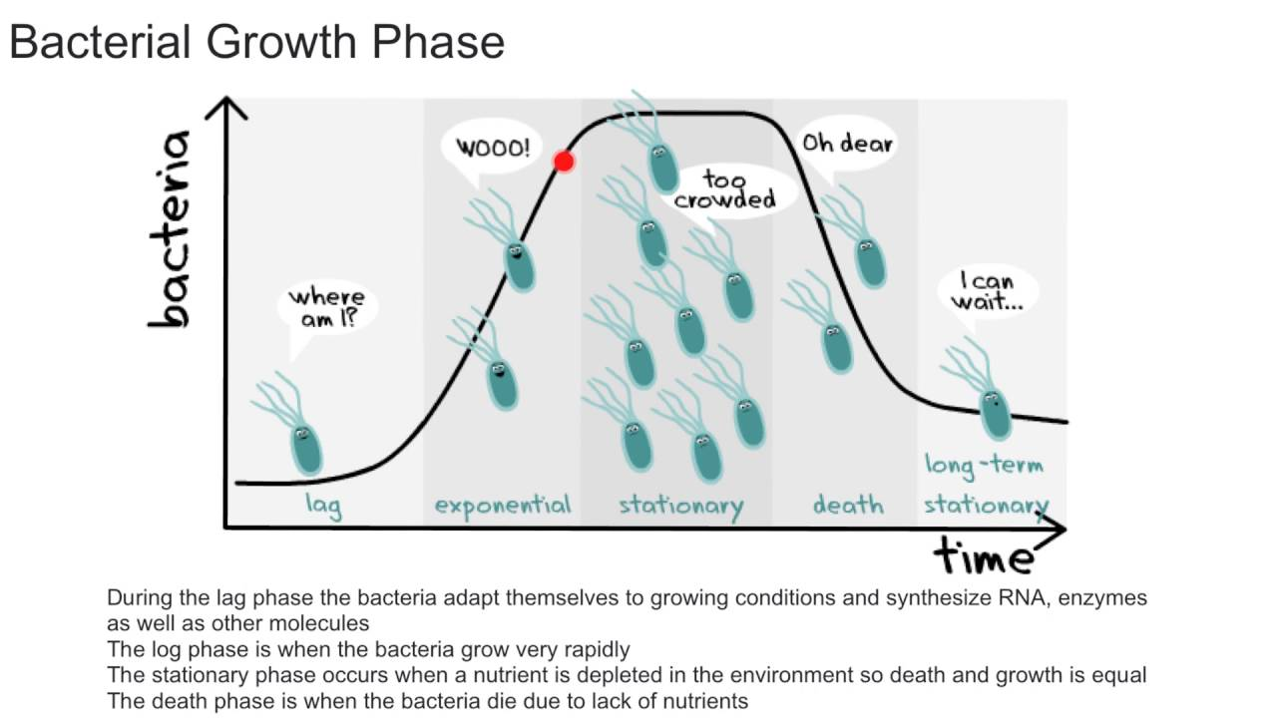
https://www.youtube.com/watch?v=gEwzDydciWc

Slide 20
How Bacteria Reproduce - Sexual Reproduction
In less favourable conditions, some bacteria can reproduce sexually via conjugation.
Since two bacterial cells are involved, this process produces new cells with new genetic combinations from both “parents” - therefore the cells may have a chance to be better adapted to any changing conditions.

Slide 21
How Bacteria Reproduce - Sexual Reproduction
During conjugation, bacterial cells become linked together by bridging structures called pili.
One bacterium transfers all (or part of) its genetic material to the other.
The receiving cell then undergoes binary fission (see previous slides) to produce more cells with this genetic makeup.

Slide 22
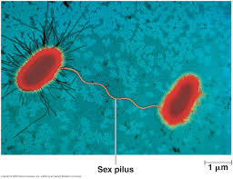

Slide 23
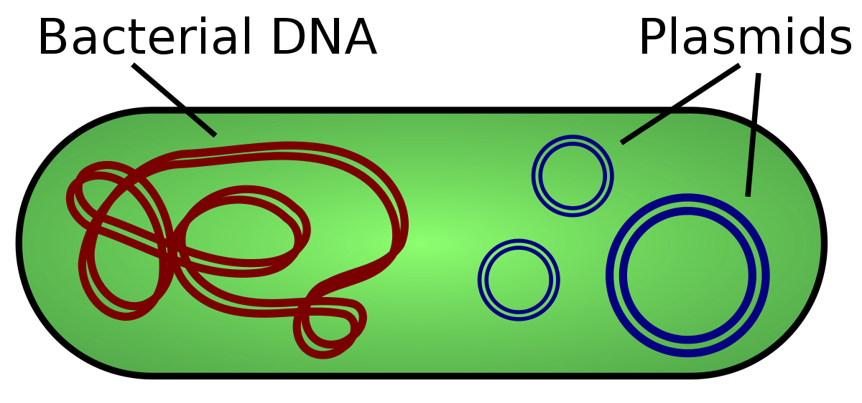
How Bacteria Reproduce - Gene Transfer
In most bacteria, the chromosome is not the only part of the cell containing genes.
Plasmids are small loops of DNA that are separate from the main chromosome.

Slide 24
How Bacteria Reproduce - Gene Transfer
Plasmids can contain one or several genes that are different from those in the chromosome.
Plasmids may be transferred during conjugation.
Scientists use this mechanism as a tool for genetic engineering: if they want to clone the human gene for producing insulin, they would separate the gene from its chromosome and splice it into a plasmid. The plasmid is then inserted into a bacterial cell where it rapidly divides.
Wanna learn more about this? Watch Unnatural Selection on Netflix!

Slide 25
How bacteria Reproduce - Spore Formation
The life cycle of some bacteria includes a dormant phase. This occurs when they are unable to survive for some reason, such as lack of nutrients. The bacteria develop a tough outer covering around their DNA and some cytoplasm.
This forms small seed-like structures called endospores.

Slide 26
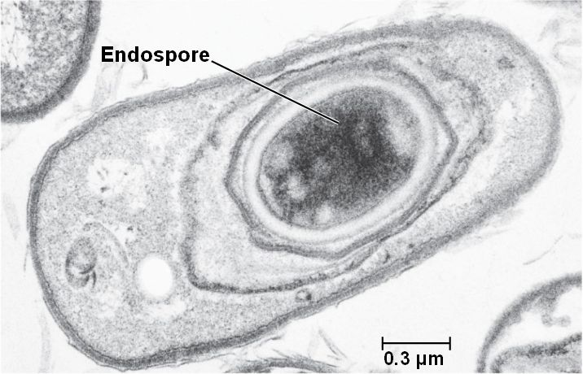

Slide 27
How Bacteria Reproduce - Spore Formation
While in the endospore stage, bacteria do not grow or reproduce.
Endospores can resist extreme heat, cold, drying out and damaging chemicals.
When favourable conditions return, the endospore breaks down and the bacteria continues as normal.

