Slide 1
Kingdom Archaea
Life Sciences 11

Slide 2
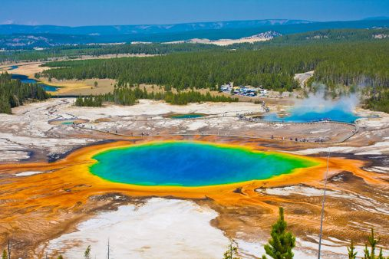
Kingdom Archaea
Earth’s most extreme-loving microorganisms are prokaryotes classified in the Kingdom Archaea
Species of archaea have been found living in hot springs, near sea floor vents at temperatures near 100 °C, in alkaline/acidic waters, and in extremely salty environments like the Dead Sea. Some even live inside volcanoes, hot coal and rocks beneath the Earth’s surface.
Grand Prismatic Lake in Yellowstone National Park. The largest hot spring in the USA is a typical home to archaea

Slide 3
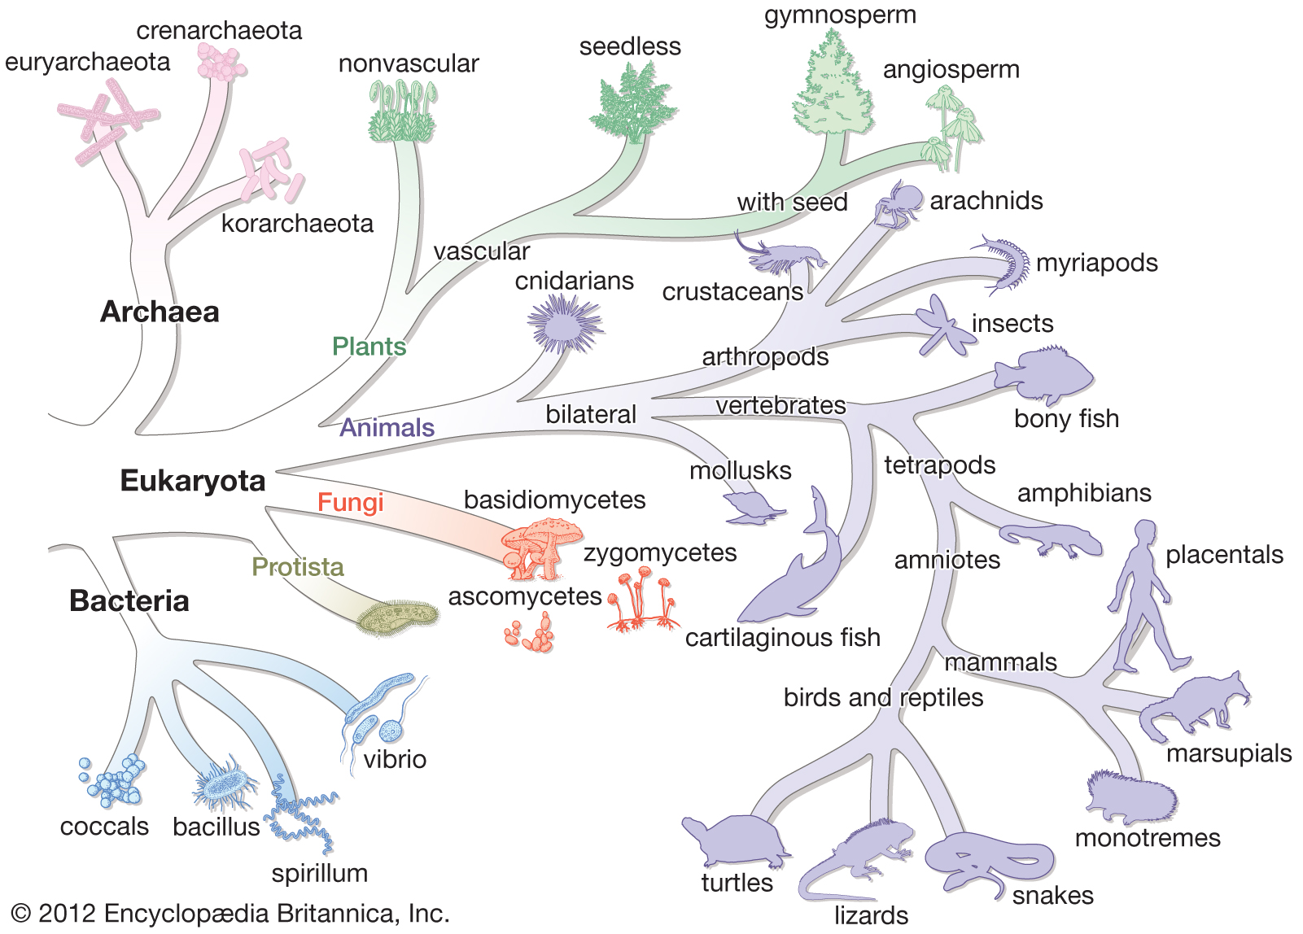
Kingdom Archaea
Archaea do not look very different from bacteria and were initially classified as a type of bacteria – the Archaebacteria.
When scientists began to analyze the cells in more detail, they found that archaea are as different from bacteria as they are from plants and animals.

Slide 4
Classifying Archaea
How are archaea able to survive in such hostile environments? Only detailed studies of their molecules and metabolism reveal the answers.
Archaea have many genes that differ from bacteria.
The cell walls of archaea have a different structure and chemical composition than those of bacteria. They have unusual lipids (fats) that remain stable at very high temperatures.
Like bacteria, archaea have different shapes (cocci, bacilli, spirilli), some move using flagella and reproduction is done by binary fission or conjugation.

Slide 5
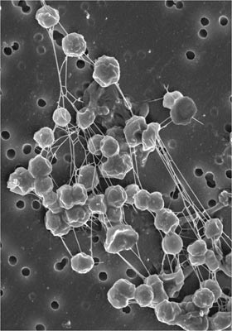
Types of Archaea
Methanogens: Methane producing archaea, live in oxygen-free environments, such as below the surface of swamps, marshes and sewage plants. They use carbon dioxide, nitrogen gas or hydrogen sulfide as a source of energy. They give off methane gas as a waste product.

Slide 6
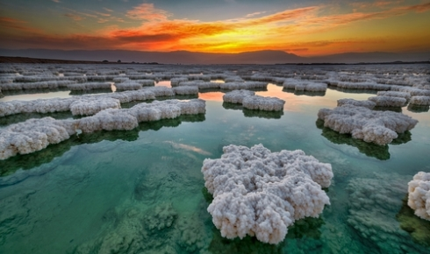
Types of Archaea
Halophiles: Salt-loving archaea that live in extreme saline environments. They can live in places with up to 15% salt concentration (seawater is 3.5% salt). They are so well-adapted to these conditions that they cannot grow in weaker salt solutions.
The Dead Sea is a common home for halophiles

Slide 7
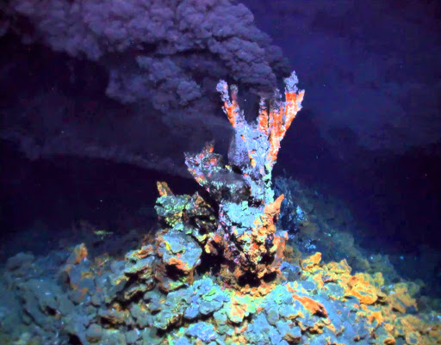
Types of Archaea
Thermoacidophiles: Heat-and-acid-loving archaea, live in extremely hot and acidic environments. Some species live in hot sulfur springs and use sulfur as their energy source. Others prefer volcanoes, or near deep sea vents, and grow best at temperatures above 80°C.
A deep sea vent

Slide 8
Archaea and Biotechnology
The ability of archaea to survive in such hostile environments is unique and still poorly understood. Scientists know that there are enzymes present only in archaea that allow them to carry out chemical and metabolic processes.
Biotechnology depends on the use of different enzymes for many processes such as DNA analysis and diagnosis disease. Standard enzymes break down very easily whereas archaean ones do not, thus making them very valuable!

Slide 9
Archaea and Biotechnology
Polymerase chain reaction (or PCR) is now a widespread technology thanks to archaea species that can grown at temperatures greater then 70°C
Polymerase chain reaction (PCR) is a method widely used in molecular biology to rapidly make millions to billions of copies of a specific DNA sample, allowing scientists to take a very small sample of DNA and amplify it to a large enough amount to study in detail.
This used to be a slow process as enzymes would often be destroyed from the high temperatures needed.

