Slide 1
Crime Scene Investigation
Part Two

Slide 2
Seven “S’s” of Crime Scene Investigation
Secure the scene
Separate the witnesses
Scan the scene
See the scene
Sketch the scene
Search for evidence
Secure and collect evidence

Slide 3
1. Securing the Scene
The first responding police officer must make sure the scene is secure by first making sure all individuals in the area are safe and second by preserving evidence. The following steps must be taken:
Obtain medical assistance if needed
Arrest suspects
Isolate the area
Exclude all unauthorized personnel
Put up tape, ropes, barricades, or position guards so no one can enter or leave. (A security log must be kept to record all who visit the scene)
Prevent the loss of evidence
Request additional needs for investigations

Slide 4
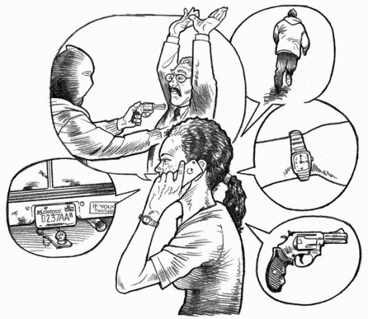
2. Separating the Witnesses
Witnesses must NOT be allowed to talk with one another. This prevents them from working together to create a false story. This is called collusion.

Slide 5
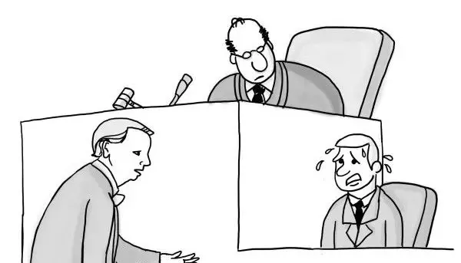
When questioning witnesses, the following questions should be asked:
When did the crime occur?
Who called in the crime?
Who is the victim?
Can the suspect be identified?
What did you see happen?
Where were you when you seen the crime occur?

Slide 6
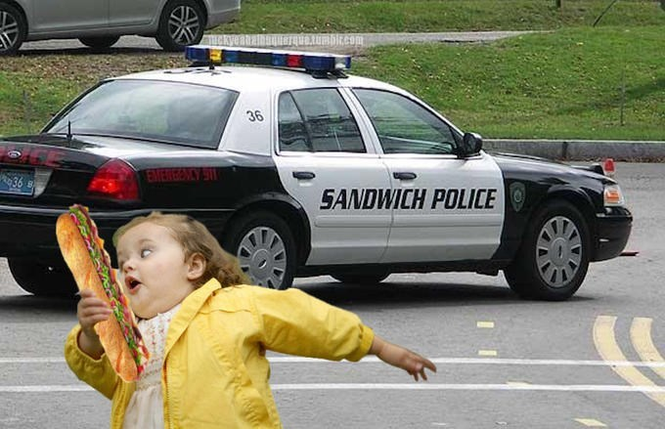
Witnesses need to be carefully examined to describe what they actually saw. Not what they thought happened.
For example: an innocent bystander running from a crime scene in fear of being shot could be mistaken for the shooter fleeing the crime.

Slide 7
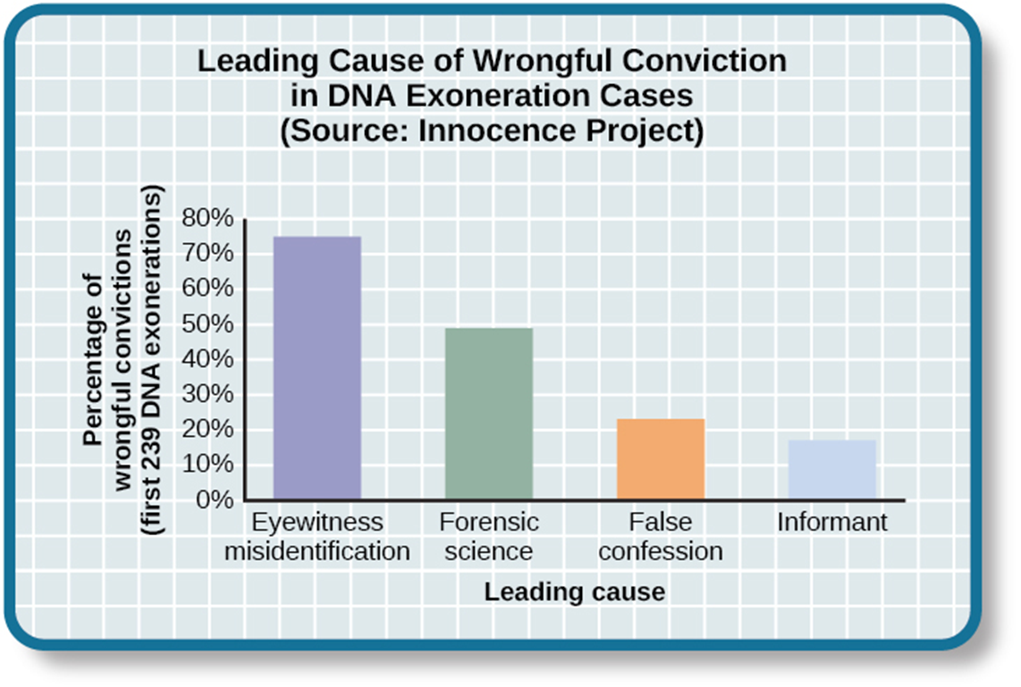
Eyewitness misidentification is the single greatest cause of wrongful convictions.
Of all overturned cases (where the original suspect was proven innocent), 75% of them were originally convicted because of witness misidentification.

Slide 8
It has been found that eyewitness identification can be quite unreliable. The human mind is not like a tape recorder – we do not record events in our brain exactly as they occurred, nor are we able to recall them in this way.
Witness memory is like any other evidence at a crime scene; it must be preserved and retrieved carefully otherwise it can be contaminated.

Slide 9
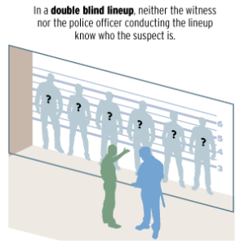
Improving Eyewitness Identification Procedures
Double-blind procedure: A line-up where neither the administrator of the test or the witness knows who the suspect is.
This prevents the administrator of the lineup from providing accidental or intentional clues as to who the witness should pick.

Slide 10
Improving Eyewitness Identification Procedures
Sequential Presentation of Lineups: When combined with a “blind” administration (from previous slide), suspects are presented one by one (sequentially) rather than all together. This has been proven to increase the overall accuracy of eyewitness identifications.

Slide 11
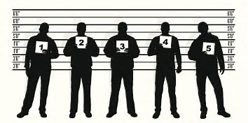
Composing the Lineup
Suspect photographs should be chosen so that they do not bring extra attention to the suspect.
Non-suspect line up members should be selected based on their resemblance to the description provided by the eyewitness not their resemblance to the police suspect.
The suspect should not obviously stand out from the others.

Slide 12
Confidence Statement & Documentation
Immediately following the line-up procedure, the witness should provide a statement about how confident they are in the selection they’ve made
The line-up procedure should be electronically recorded using a video camera. If this is not possible, an audio or written record should be made.

Slide 13
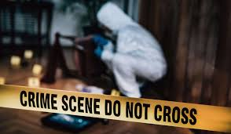
3. Scan the Scene
Forensic examiners scan the scene to see where photos should be taken. Then the primary and secondary crime scenes must be determined.
The primary crime scene is where the crime actually occurred.
The secondary crime scene is in some way related to the crime but is not where the actual crime took place.

Slide 14
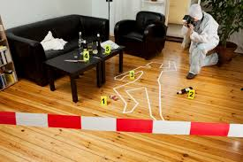
4. See the Scene
A crime scene examiner looks at the scene. The photography unit will take photos of the entire area, and then will take close-up photos with a ruler for reference.

Slide 15
5. Sketching the Scene
North should be labelled and a scale of distance should be included.
All important objects (weapons, body, etc…) should be measured from two stationary landmarks (for example, from the walls)
Any other objects in the vicinity of the crime should be included (doors, windows, furniture, trees, vehicles, etc…)
Also include: date, time, location, case number and names.

Slide 17
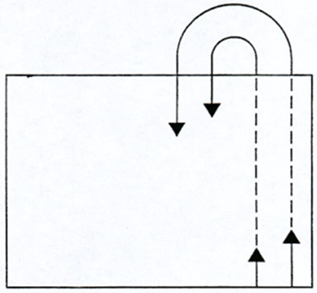
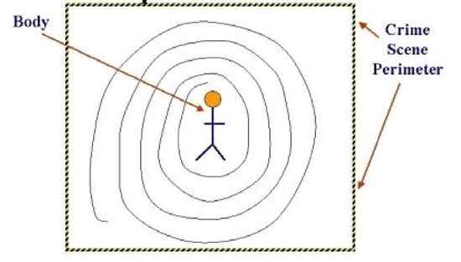
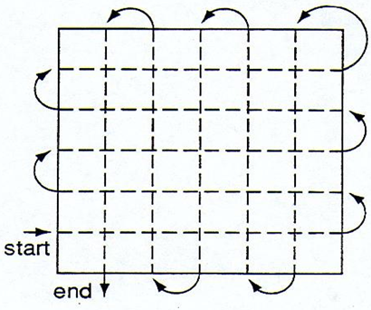
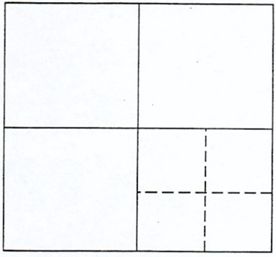
6. Search for Evidence
A pattern should be walked and locations of evidence marked, photographed and sketched.
Spiral Linear
Grid Quadrant

Slide 18
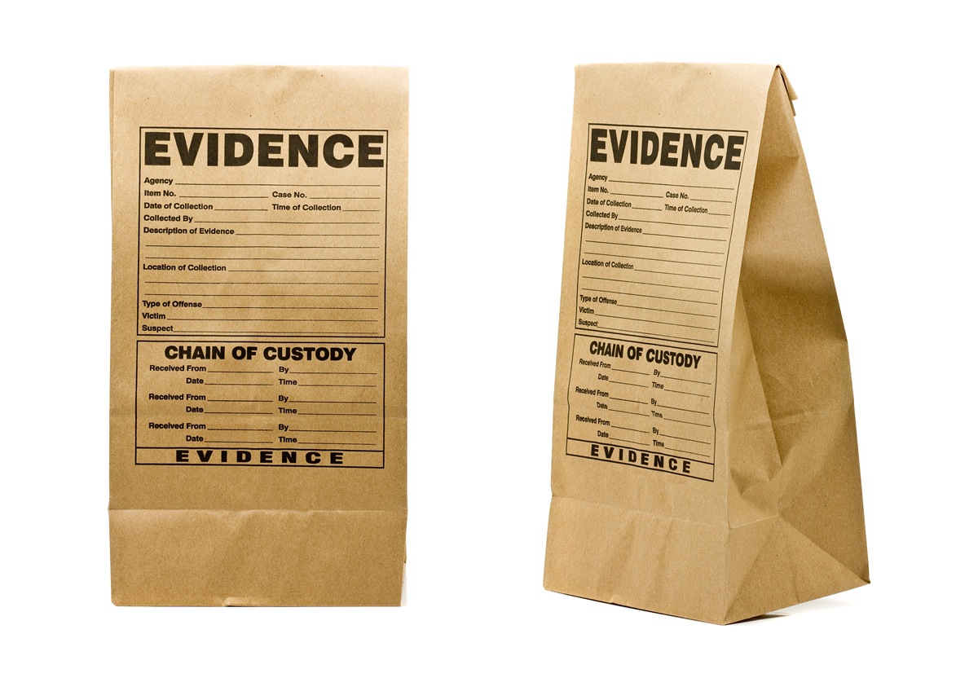
7. Securing and Collecting the Evidence
All evidence must be properly packaged, sealed and labelled using specific techniques and procedures.
Packaging evidence:
Metal or plastic forceps (tweezers) may have to be used to pick up small items.
Plastic bottles with lids are preferred containers for hair, glass, fibers and other kinds of trace evidence
Liquids and arson (fire) remains are stored in airtight containers.

Slide 19
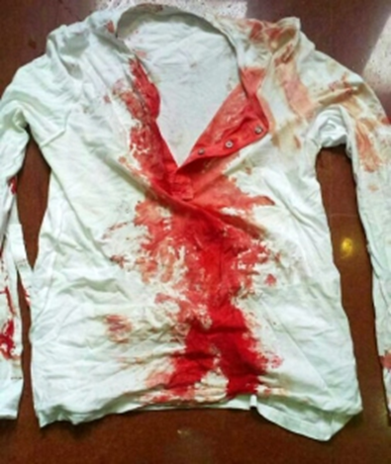
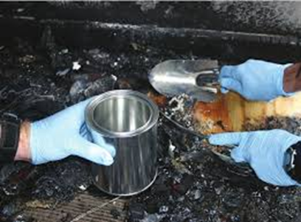
7. Securing and Collecting Evidence Cont.…
Bloodstained materials must be packaged in wrapping paper, envelopes, or paper bags to prevent the growth of mold which can destroy the evidential value of the blood. Air must be able to flow around the evidence to prevent moisture buildup.
Charred debris from a fire must be sealed in an airtight container, such as new metal paint cans, to prevent any residues from evaporating. This could be evidence of arson.

Slide 20
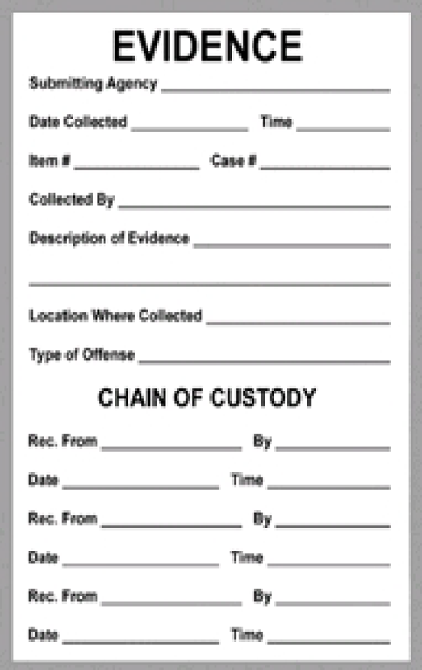
Evidence Log & Chain of Custody
An evidence log and a chain of custody must be attached to the evidence container.
It should include a description of evidence, name of suspect, name of victim, date and time of recovery from crime scene, signature of person who recovered the evidence and signature of any witnesses present during collection.
Chain of Custody is a list of all persons who come into contact or possession of an item of evidence.

Slide 21
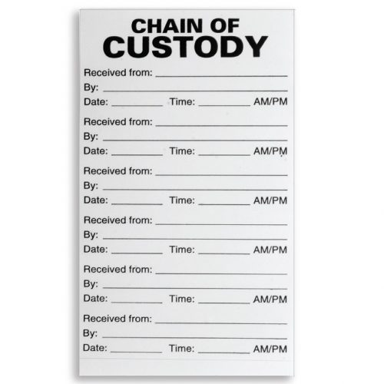
Evidence Log & Chain of Custody
Each person who comes into contact with a piece of evidence must use proper procedure and protocol in order to maintain responsible handling of evidence from crime scene to courtroom. If this does not happen, then the evidence will not be admissible in court.

Slide 22
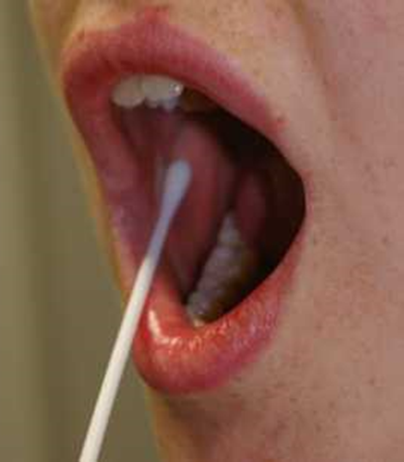
Control Samples
Control samples should also be taken from the victim for purposes of exclusion (to make sure they are not a suspect)
Standard/Reference Sample: Physical evidence whose origin is know such as blood or hair from a suspect, that can be compared to crime scene evidence.
These are obtained from the victim, family members, any paramedics or police officers who may have been in the crime scene and potential suspects.
When there is bloodstained evidence, a whole blood sample or a cheek (buccal) swab must be obtained from all crime scene participants.

Slide 23
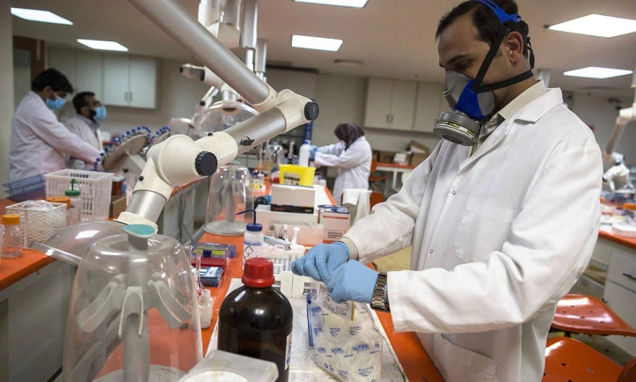
Analyze the Evidence
Forensic labs process all evidence the crime scene investigation team collected.
Forensic lab technicians are specialized and process only one type of evidence – not like what you see on CSI television shows!
Lab results are sent to the lead detective.

Slide 24
Crime Scene Reconstruction
Crime scene reconstruction allows the detectives to form a hypothesis of the sequence of events before a crime was committed.
Evidence does not lie, but it can be staged. To determine this, the following points should be considered.
Initially treat all death investigations as homicides
Ensure the wounds on the victim match the weapon
Determine if the wounds could be self inflicted
Evaluate the behavior of the victim and any suspects before the event.
Make sure all statements match the facts.
Reconstruct the event.

Slide 25
Legal Considerations
Evidence cannot be removed from a crime scene, unless there is probable cause or a warrant has been issued.
Probable cause: reasonable grounds (for making a search, pressing a charge, etc.)
Warrant: a document issued by a legal or government official authorizing the police make an arrest, search premises, or carry out some other action relating to justice.
A warrantless search can be conducted:
Under emergency circumstances (danger to life)
There is immediate danger to the evidence
There is probable cause
There is consent

