Slide 1
Crime Scene Investigation
Science for Citizens 11
Mackenzie Secondary School

Slide 2
Crime Scene Investigation
The goal of crime scene investigation is to recognize, document and collect evidence at the scene of a crime.
Solving the crime will depend on piecing together the evidence to form a picture of what happened at the crime scene.

Slide 3
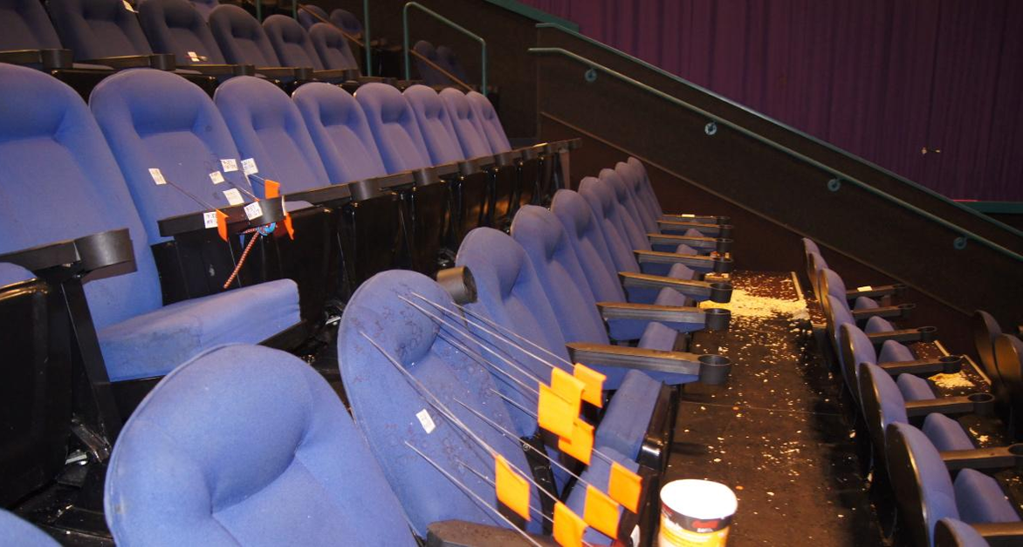
The photo above is from the Aurora, Colorado movie theatre shooting.
https://www.cnn.com/2013/07/19/us/colorado-theater-shooting-fast-facts/index.html

Slide 4
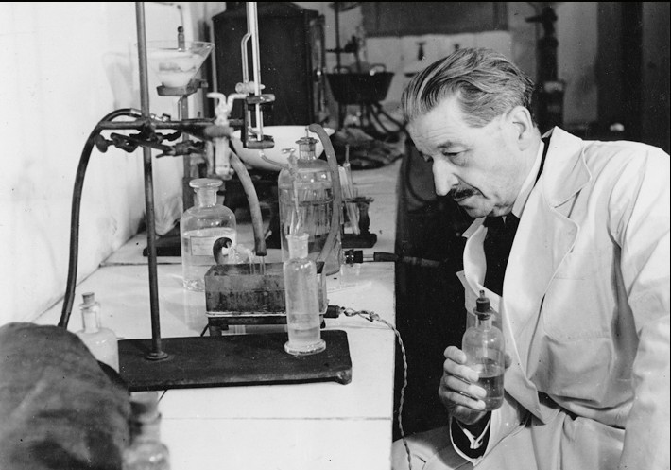
The Locard Exchange
Dr. Edmond Locard was a French criminologist, the pioneer in forensic science who became known as the "Sherlock Holmes of France".
He created the basic principle of forensic science: "Every contact leaves a trace". This became known as Locard's exchange principle.

Slide 5
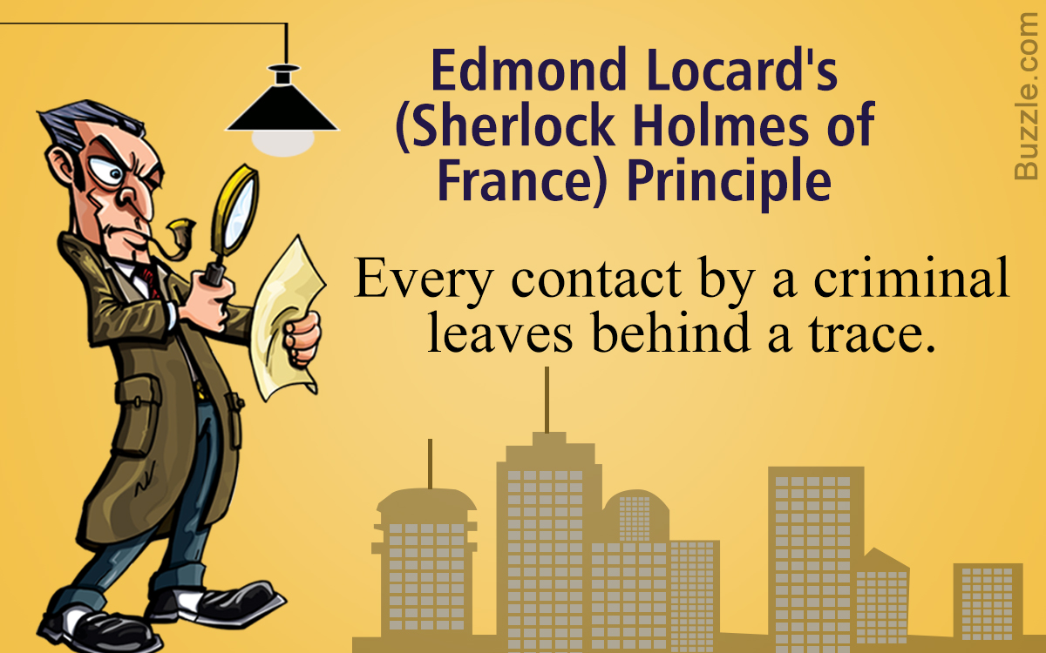
The Locard Exchange
Basically, whenever 2 objects come into contact with one another, a cross transfer of physical evidence can occur between the two objects.
The intensity, duration, and nature of the materials in contact determine the extent of the transfer.

Slide 6
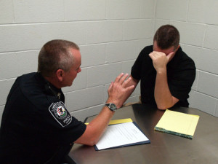
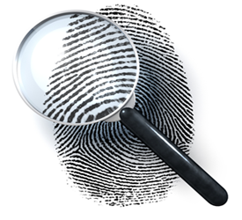
Evidence can be classified into two types:
Direct evidence: First hand observations, such as eyewitness accounts, videos and confessions to the crime.
Circumstantial evidence: indirect evidence that can be used to imply a fact but does not directly prove it. For example, finding a suspects gun at a crime scene is circumstantial evidence that the suspect may have been there but does not prove it for a fact.

Slide 7
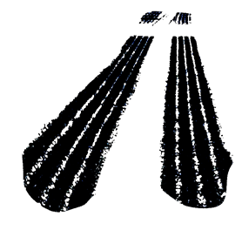
Types of Circumstantial Evidence
Physical evidence: synthetic fibers, weapons, bullets shell casings, paint chips, documents, shoe prints, tire prints, tool marks, soil, drugs, etc…
Biological evidence: body or body parts, bodily fluids, hair, leaves or other plant parts, natural fibers, feathers, wood.
Trace evidence: small but measurable amounts of physical or biological material found at a crime scene. Examples include: a strand of hair, fingerprint, DNA, drop of blood, pollen, gunshot residue.

Slide 8
Importance of Circumstantial Evidence
The more circumstantial evidence there is, the greater the weight it carries.
Circumstantial evidence must be closely examined and looked at as a whole.
A court would be very slow to convict a defendant on the basis of one piece of circumstantial evidence alone.
BUT if there were many samples of circumstantial evidence then they would have more weight together.
For example, in a theft case, if the suspect was seen in the area at the time of the theft, their fingerprints were found at the scene and they had a large sum of money that they could not explain – then the court would be more likely to convict.

Slide 9
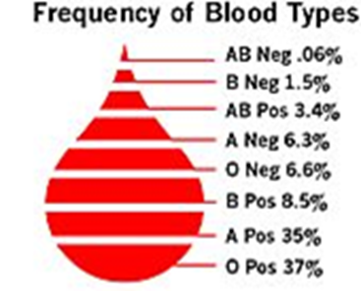
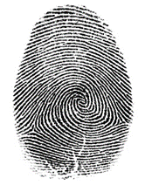
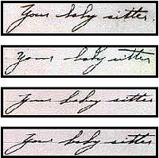
Evidence can also be divided into:
Class evidence: when evidence can be narrowed to a group of persons or things.
Example: blood types – there are 8 total blood types. Finding one type at a crime scene narrows down the suspects to a smaller group.
Individual evidence: narrows evidence down to a single person or thing.
Example: fingerprints, handwriting, DNA

Slide 10
Fingerprint Identification
No two people have the same fingerprint! That means a good fingerprint sample can be used to help solve a crime.
Fingerprints are impressions created by ridges on your skin along with the natural oils that your skin produces. Everyone has a unique pattern – they form before you are born and stay all through your life unless they have been damaged.

Slide 11
Fingerprint Identification
Skin is made of two layers: the dermis and the epidermis.
The dermis is the deeper layer where the sweat glands, oil glands, nerves and blood vessels are.
The epidermis is made of thin layers in the ridge patterns. The outermost cells are dead and dry up and fall off eventually.
When a person touches an object, the sweat, oils and cells on their skin are transferred to the object. A fingerprint!

Slide 13
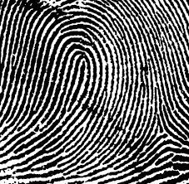
Fingerprint Identification
Everyone has different fingerprints but there are general patterns that allow them to be classified and compared.
Loops are found in 65% of the population.

Slide 14
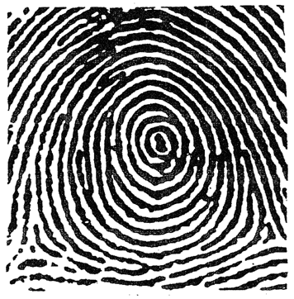
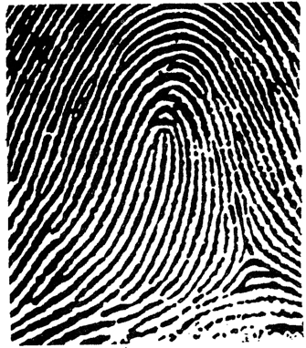
Fingerprint Identification
Whorls are found in 35% of the population.
Arches are found in 5% of the population

Slide 15
Importance of Evidence
Can prove a crime has been committed and set the scene for the investigation.
Can back up witness testimony or prove it false
Can link a suspect with a victim or with a crime scene
Can determine the identity of people associated with a crime
Allows investigators to reconstruct a crime.

Slide 16
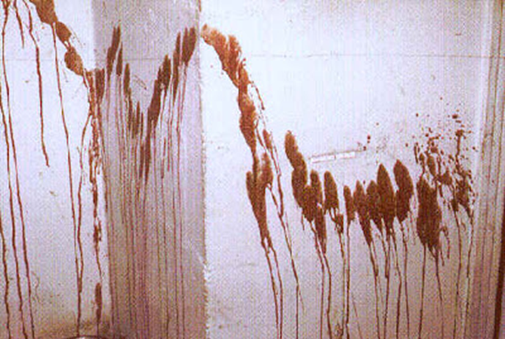
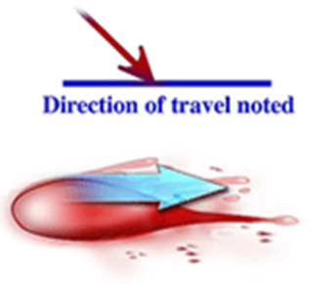
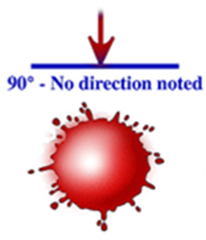
Blood Splatter
Blood splatter may show where suspect and victim were in relation to one another and indicate what happened and in what order.

Slide 17
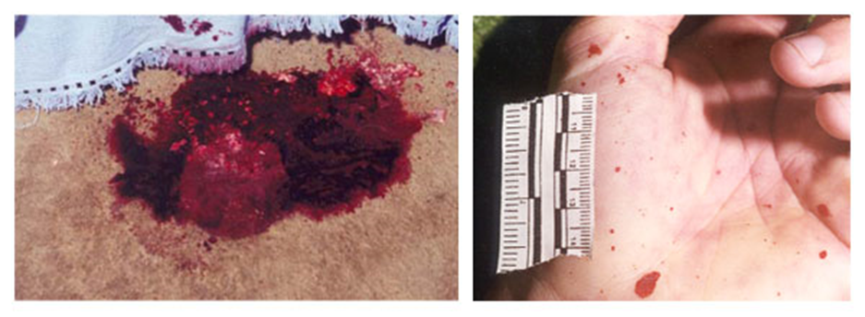
Blood Splatter
Size, shape, pattern and amount of blood that is left will often leave clues as to what happened at the crime scene.
Left: the large pool of blood may indicate the victim was stationary/victimized in that location. Right: impact splatter. Amount, size and pattern need to analyzed to determine instrument used.

Slide 18
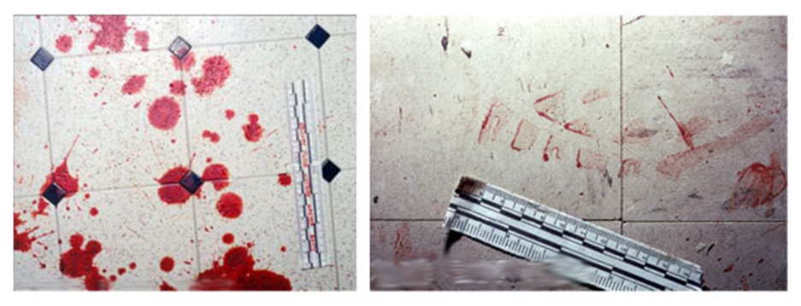
Blood Splatter
Forward spatter from a gunshot would will typically form smaller droplets spread over a wide area, while impact spatter will form larger drops and be more concentrated in the areas directly next to the action.
Left: passive blood stains (could be a blunt trauma that caused someone to bleed)
Right: bloody shoe print transfer pattern

Slide 19
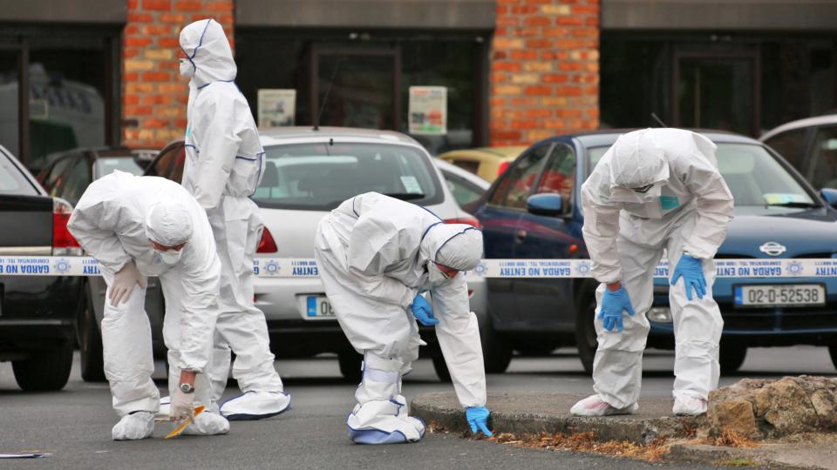
The Crime Scene Investigation Team
First police officer on the scene.
Backup police and possibly a district attorney
Medics
Investigator/detective
Medical examiner
Photographer and/or field evidence technician
Lab experts
All must wear protective gear to prevent contamination of the crime scene.

