Slide 1
Classification of Life
Life Sciences 11
MSS

Slide 2
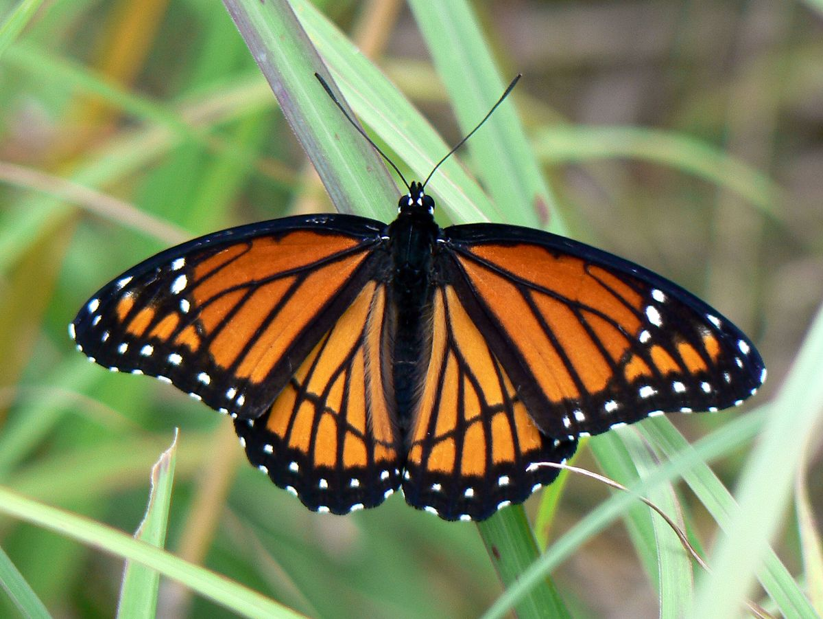
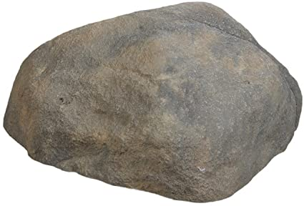
Characteristics of Life
What defines life?
How can you say with certainty that a Viceroy butterfly is alive but a rock is not?
Biologists do not try and define what “life” is (we leave that to the philosophers). Instead, they attempt to describe features or characteristics that are shared by all living things.

Slide 3
How Biologists Describe Living Things
1. Living things are organized systems made up of one or more cells.
2. Living things metabolize (use) matter and energy.
3. Living things interact with their environment and are in homeostasis (balance).
4. Living things grow and develop.
5. Living things reproduce.
6. Living things adapt to their surroundings.

Slide 4
Classifying Living Things
All living things can be organized into groups that share certain characteristics.
For biologists, classification is a valuable way of learning how organisms may be related to each other.
Biologists have identified over 1.5 million different species of organisms and estimate that there could be another 20 million to be discovered.

Slide 5
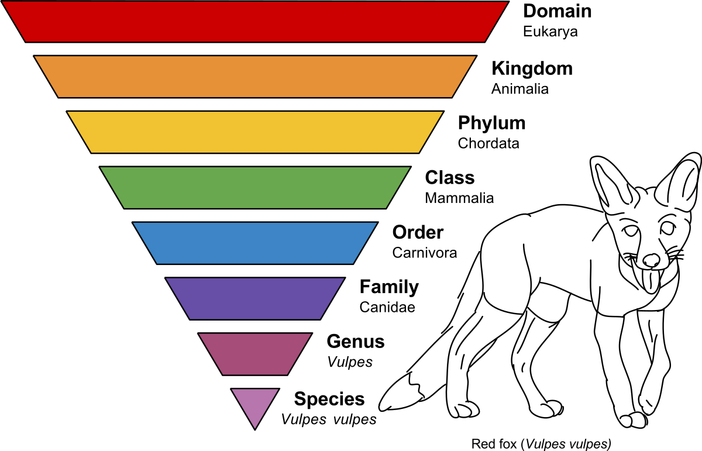
Taxonomy
The branch of biology that deals with naming and classifying organisms into groups
Taxonomists place organisms into groups based on their characteristics and evolutionary relationships

Slide 6
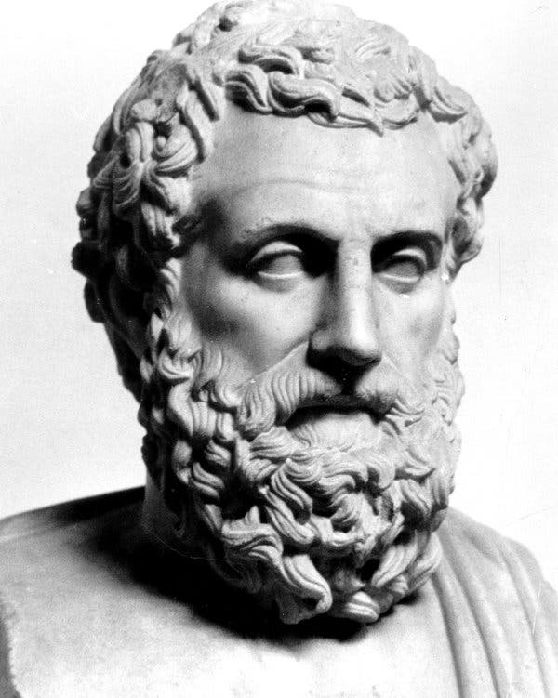
Early Classification Schemes
Aristotle, a Greek philosopher, was the first to use a classification system.
He placed all organisms into two groups
Plants
Animals
Then classified them based on the environments or where they lived.

Slide 7
Early Classification Schemes
This is how Aristotle imagined the classification of life.
Living Thing
Animals
Air
Water
Land

Slide 8
Early Classification Schemes
Theophrastus was a student of Aristotle
Further classified plants according to their stem structure. He is now known to be the “Father of Botany”.
Plants
Herbs
Soft Stems
Shrubs
Several Woody Stems
Trees
Single Woody Stem

Slide 9
A Third Kingdom?
With the invention of the microscope and the discovery of microscopic organisms there was now a need for further classification
Organisms that were neither plant nor animal needed a home.
Single celled organisms were placed in a kingdom called Protista

Slide 10
Classification As We Know It
As biologists learned more about the structure and life patterns of different organisms, more kingdoms were added.
Now, we have six kingdoms of classification!

Slide 11
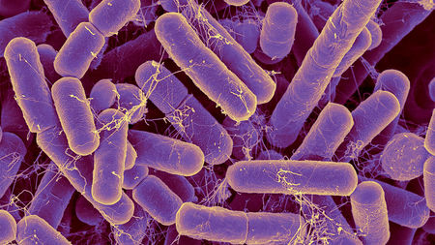
1. Kingdom Eubacteria
Simple organisms. Cells do not have nuclei. They are PROKARYOTES.
Bacteria can be heterotrophic or autotrophic.
They reproduce asexually or sexually
Live nearly everywhere
Example: E. Coli

Slide 12
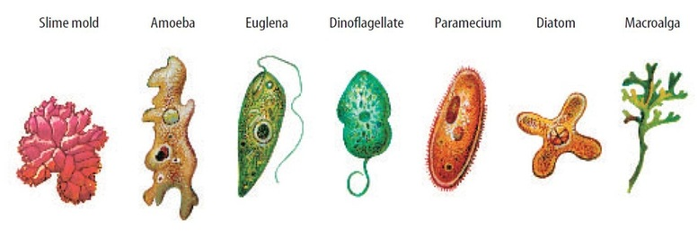
2. Kingdom Protista
Most are single-celled
Heterotrophic, Autotrophic, or both
Sexual and asexual reproduction
They usually live in aquatic or moist habitats
Example: Simple Algae and Protozoans

Slide 13
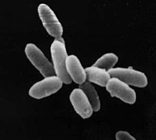
3. Kingdom Archaebacteria
“Bacteria” like organisms which tend to live in extreme environments
Salt lakes or hot springs
Possess structures which allow them to survive in these hostile conditions
Structures not necessarily present in other organisms
Different makeups of their cell walls and cell membranes
Example: Thermococcus litoralis
Grows near deep sea vents.

Slide 14
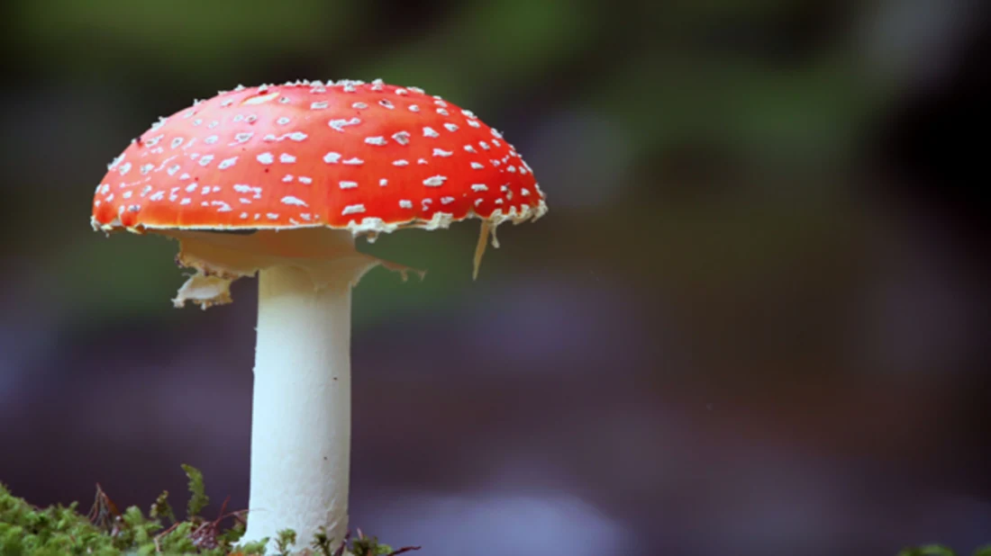
4. Kingdom Fungi
Most are multicellular
Are all heterotrophic
Reproduce sexually and asexually
Most are terrestrial
Examples: mushrooms, bread mould

Slide 15
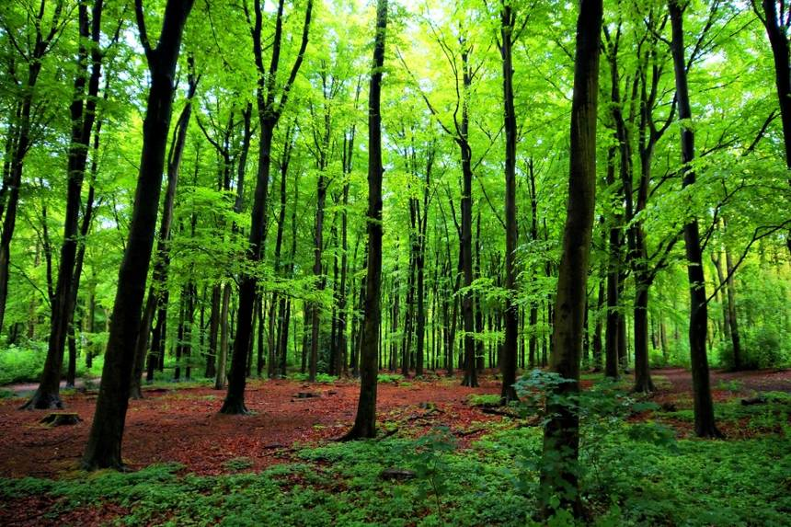
5. Kingdom Plantae
All multicellular
All autotrophic
Reproduce sexually and asexually
Most are terrestrial
Example: Moss, coniferous trees, flowering plants

Slide 16
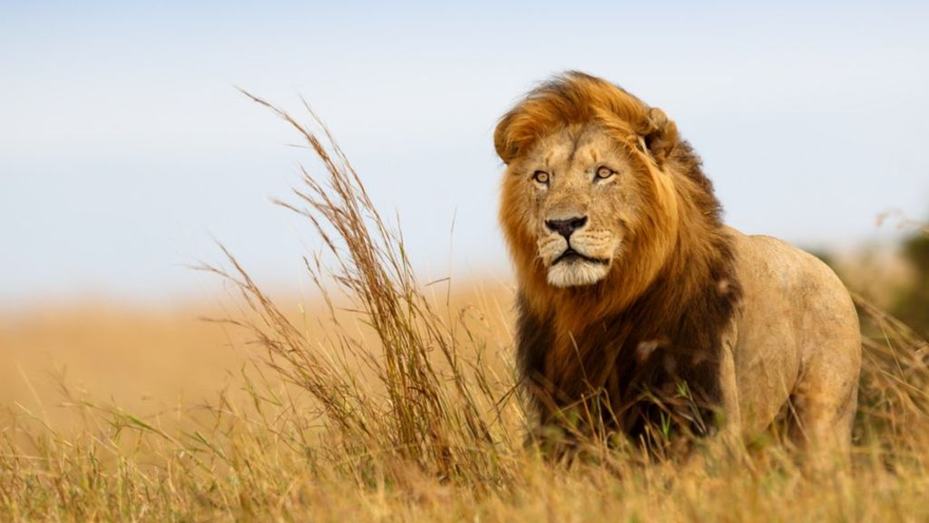
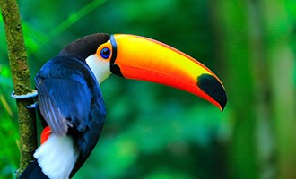
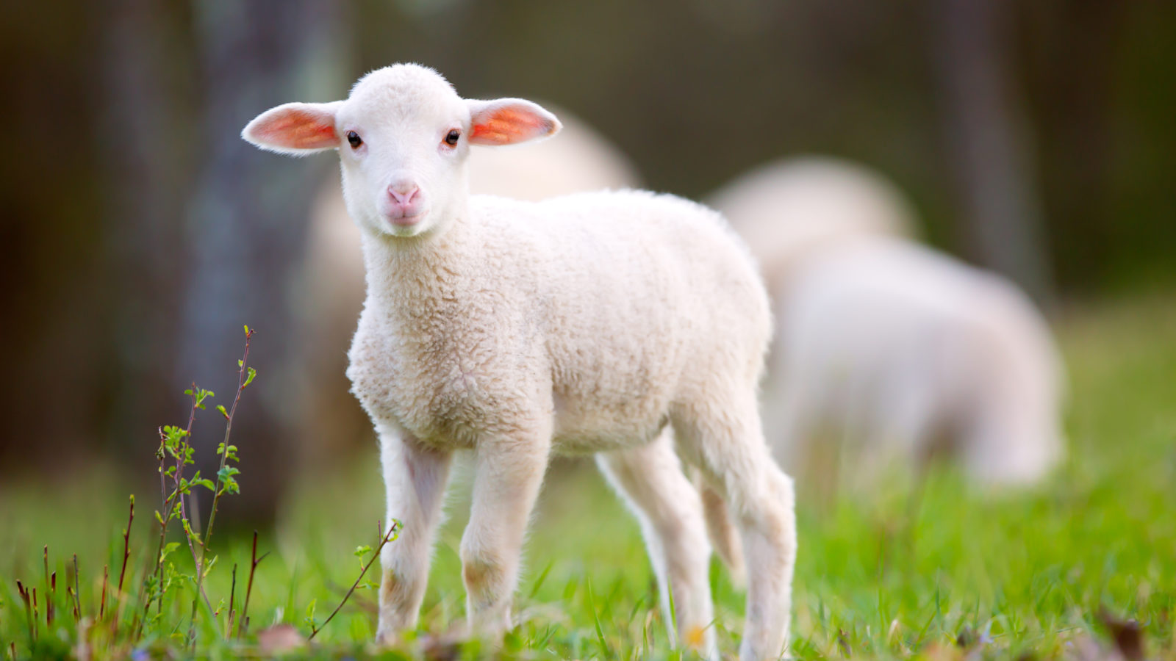
6. Kingdom Animalia
All multicellular
Most reproduce sexually
Both terrestrial and aquatic
Examples: sea sponges, worms, wolves, humans

Slide 17
Cell Structure and the Domains
Let’s backtrack a little bit…there are two basic cell types on earth… Prokaryotes and Eukaryotes
*How to pronounce: PRO CARRY OATS and YOU CARRY OATS*
Prokaryotes are organisms whose cells do not have a nucleus or most other organelles. Bacteria and Archaea are prokaryotes. They are the smallest living cells.
Eukaryotes are organisms whose cells have nuclei and other organelles like mitochondria. Protista, Fungi, Animals and Plants are all eukaryotes.

Slide 19
Classification by Domains
As a result, taxonomist’s have created a new level of classification above kingdoms
This new level of classification is called Domains
Domains are based on the type of cells of living organisms.
SO, this means that all LIFE is organized into THREE DOMAINS… BACTERIA, ARCHAEA and EUKARYA.
The three domains are then separated into SIX KINGDOMS… EUBACTERIA, ARCHAEBACTERIA, PROTISTA, FUNGI, PLANTAE, ANIMALIA.

Slide 20
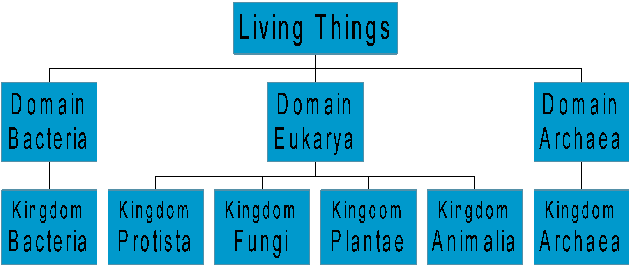
Classification by Domains

Slide 21
Modern Biological Classification
Hierarchical Classification

Slide 22
Carolus Linnaeus
Carolus Linnaeus was a Swedish botanist who used simple physical characteristics to identify different species and organize them into groups. He developed a system based on an organism's’ physical and structural features.
Using this system, he recognized that the more features two living things have in common, the closer their relationship.
Using this system, people could accurately identify an organism by comparing its appearance to a “checklist” of characteristics.

Slide 23
Hierarchical Classification
Linnaeus devised a way to distinguish the different degrees of similarity between different species
He divided each kingdom into smaller subdivisions
Each group is called a taxon

Slide 24
Hierarchical Classification
Kingdoms are the largest and most general taxa
Species are the smallest taxa
Between kingdoms and species, organisms are further classified into five other taxa
This forms the “hierarchy”.

Slide 25
7 Categories of Linnaeus’ Classification
Try this acronym to remember all of the taxa (taxa is plural for taxon)
King
Phillip
Came
Over
For
Good
Soup
Kingdom
Phylum
Class
Order
Family
Genus
Species

Slide 26
Don’t Forget About the Domains!

Slide 27
Note that similarity increases as we move down the ladder – variety of species decreases
Last hierarchical groups (species) identifies only one kind of organism

Slide 28
How do we name organisms?
Binomial Nomenclature

Slide 29
Binomial Nomenclature
Created by Carl Linnaeus
Each organism is assigned a two part Latin name, which is its scientific name
Scientific name often very different from common name
Ex: Homo sapiens is the scientific name. Human is the common name.
The first word in the scientific name is the genus in which the organism is classified
First letter of this name must be capitalized
The second name is the species
Latin is used because this language was once the common language around the world for science!

Slide 30
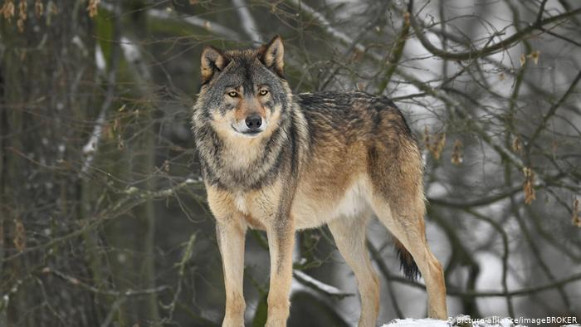
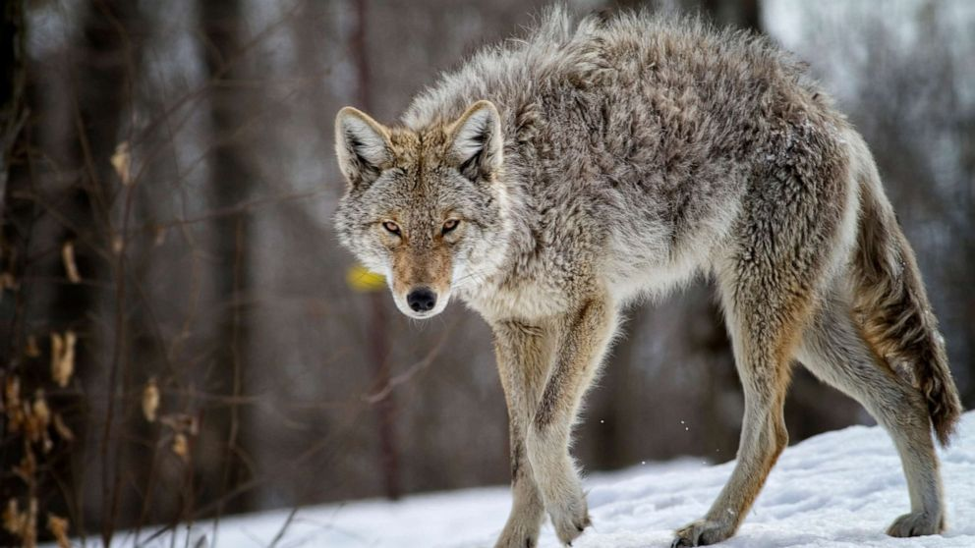
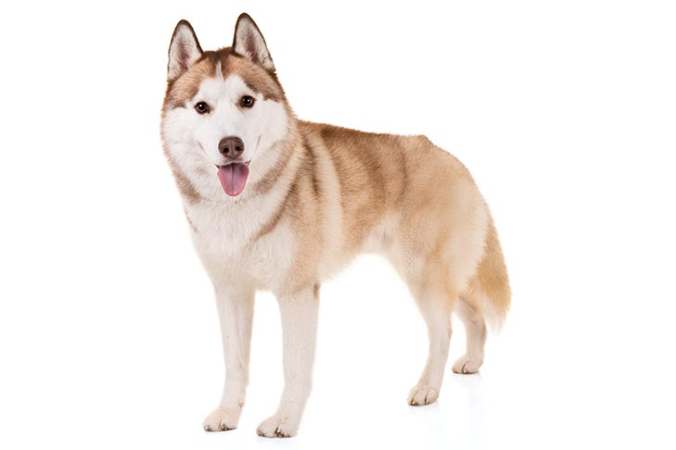
Binomial Nomenclature
Because a genus may have many species, there may be many species with the same scientific first name
For example:
Canis lupus (wolf)
Canis latrans (coyote)
Canis familiaris (dog)
Because they all share the first name you know they are all apart of the same genus
I.e. They are closely related

Slide 31
Classification and Naming - Humans
Kingdom: Animalia
Phylum: Chordata
Class: Mammalia
Order: Primates
Family: Hominidae
Genus: Homo
Species: Sapien
To name a human using binomial nomenclature we would say Homo sapien (Genus first, then species)

Slide 32
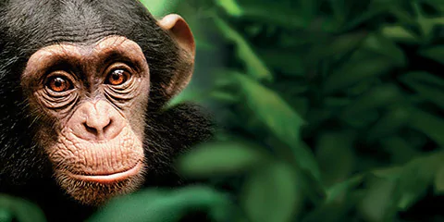
Classification and Naming - Chimpanzee
Kingdom Animalia
Phylum Chordata
Class Mammalia
Order Primates
Family Hominidae
Genus Pan
Species Troglodytes
How would you name a chimpanzee using binomial nomenclature?

Slide 33
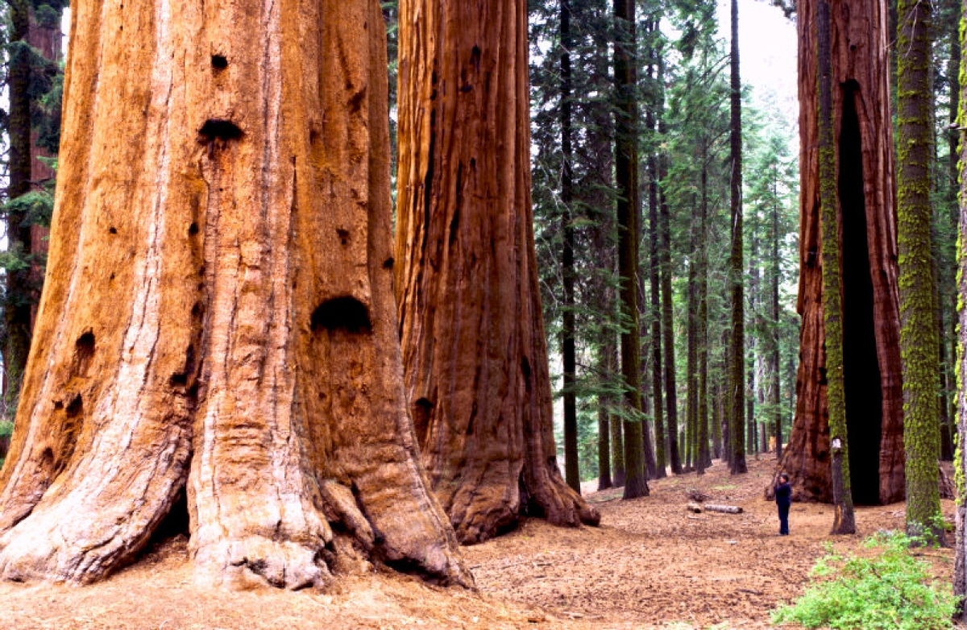
Classification and Naming – Giant Redwood
Kingdom Plantae
Phylum Pinophyta
Class Pinopsida
Order Pinales
Family Cupressaceae
Genus Sequoiadendron
Species Giganteum

Slide 34
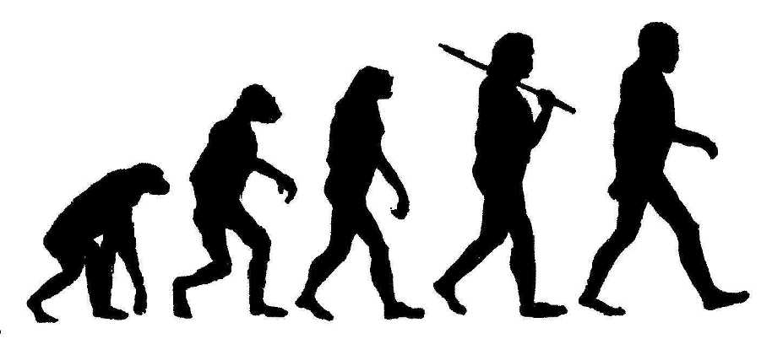
Benefit of a Universal Naming System
Eliminates confusion with common names
Allows us to distinguish all of the variety of living things on earth
More importantly, it tells us something about evolutionary relationships

Slide 35
Dichotomous Keys
A dichotomous key is a tool that allows the user to determine the identity of items in the natural world, such as trees, wildflowers, mammals, reptiles, rocks, and fish.
Keys consist of a series of choices that lead the user to the correct name of a given item. "Dichotomous" means "divided into two parts".

Slide 36
Dichotomous Keys
Dichotomous keys are very useful because they allow non-expert users to identify organisms by directing them to look at the known, important organisms. Many people might not know how to distinguish different species of pine trees based on the arrangement of needles on a branch, for example, but the key would be able to ask them that question and give them useful information based on the result.

Slide 37
Example of a Dichotomous Key
Imagine you found ten different species of tree that you would like to identify. A dichotomous key is like a “create your own adventure” book, where each question you answer takes you to a new question.
Try this one out!
https://oregonstate.edu/trees/dichotomous_key/broadleaf_1.html

